Slide 1
How Corporate Social Responsibility Can Enhance Event Sponsorship Effectiveness
Angeline Close, University of Nevada Las Vegas
Russell Lacey, Xavier University

Slide 2
Shell Houston Open
Major PGA Event
Wed-Sunday Event Measurement
Multi Million Dollar Naming Rights
Our goal today: Pre-test survey design
Ill show you an activation process model

Slide 3
Research Focus, Angeline Close, PhD
EVENT MARKETING
~Influencing behaviors in
society & sports
~ Building relationships with
consumers through events
~Providing services to
consumers through events & sponsorships
~Demonstrating value
& effectiveness of events &
sponsorships
~Engaging consumers via
events via affect transfer
~The relationship of exhibits &
consumer product knowledge
~Enhancing purchase intentions
~Consumer-sponsor-event fit
~Resistance to special events
E-CONSUMER BEHAVIOR
~Online ad response
~Determinants of cart abandonment
~Motivations for e-cart use
~Online identity &
cyber identity theft
~Virtual ad agency
~Effectiveness of e-mail
use in advertising
~Online search behavior
~Book in progress:
“Online Consumer Behavior:
Theories & Application of
Social Media and
Online Advertising”
~Co
Virtual event effectiveness
~Use of online advertising to influence event
Behavior
~

Slide 4
Event Sponsorship as a CSR Tool
Today’s socially responsible corporations aim to benefit the individual, workplace, organization, and community—via event sponsorship.
Sponsorship enhances goodwill and public relations for the benefactors-assumption…
No one has measured CSR outcomes of a live sporting event with a charitable benefactor.
Here, I examine:
a) what drives perceived corporate social responsibility (CSR), &
b) outcomes of enhanced CSR perceptions for an event sponsor with a beneficiary
…via a field study (n=1,615) at the AT&T Tour de Georgia (Cycling Race) to benefit the Georgia Cancer Coalition

Slide 5
Why Sponsor an Event?
Given the economy, some sponsors cut or lessened event sponsorship investments/ beneficiaries
Other sponsors continue heavy investments (e.g., AIG sponsoring Manchester United soccer jerseys)
What are some benefits to event sponsorship?
May enhance CSR perceptions (focus of study here)
Reach small segments and niches (e.g., cyclists)
May help make an event happen
Lends credibility to a sponsor
Brings a brand to life/emotion
Boosts morale—employees & consumers
Gives sales opportunities during & after event
Cuts through clutter (of traditional advertising)
Easily leveraged with IMC
A less-intrusive, growing approach relative to advertising

Slide 6
Worldwide Sponsorship Investments Source: International Events Group (IEG)
Event-sponsorship has been a long-established practice, and a growing component of IMC strategy
(in $US billions)

Slide 7
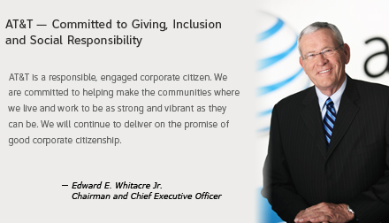
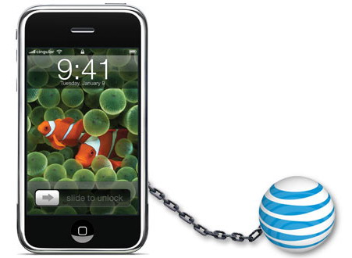
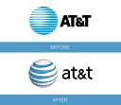
Using Sponsorship to Enhance CSR
Especially important to demonstrate community involvement for “powerhouse brands” like AT&T to show a softer side

Slide 8
Sponsorship Categories (USA)
Sports (69%)
Entertainment, Tours & Attractions (10%)
Cause-Related Marketing (9%)
The Arts (5%)
Festival, Fairs & Annual Events (4.5%)
Associations & Membership Organizations (3%)
(Source: IEG)

Slide 9
Image Transfer Theory
Sponsorship may act as conduit to transfer affect associated with sponsored event to sponsor brand.
Keller’s (1993) theory regarding brand linkages states that this link influences consumers’ brand associations.
Consumers develop associations from their experiences (e.g., brand and product category experiences, witnessing typical brand users), product attributes, promotions, packaging, price, and usage occasion.
Such extant associations regarding an event become linked in memory with the sponsoring brand and its image.
In essence, the event image transfers to the sponsoring brand.

Slide 10
Event Sponsorship Process
Image
transfer
SPONSOR
(e.g., AT&T)
Gives $ or in kind support
EVENT
(e.g., Tour de GA)
Contribution to communication objectives & or beneficiary
MEDIA
(leverages sponsorship to targets of)
SPONSOR
ACTIVITY
MEDIA
BENEFICIARY

Slide 11
Research Objectives
examine consumers’ perceptions of a corporate event sponsorship and explain how consumers’:
knowledge of the sponsoring brand,
activeness in the event domain, and
perceptions of an event’s entertainment value influence their perceptions of the sponsor as socially responsible.
show how consumers’ assessments of perceived CSR influences brand commitment and intentions to purchase the sponsor’s products.
Uncover the relative importance of event-sponsor congruity for sponsor (and not necessarily for event)

Slide 12
Conceptual Model
Event
Sponsor
Event Entertain-ment
Brand Knowledge of Sponsor
H1
H5^{(*)}
Attitude toward Event
Brand Commit-ment
H4*
Activeness in Event Domain
Sponsor’s CSR
H6^{(*)}
H3
H2
H8^{(*)}
H7^{(*)}
Purchase Intent
*Each sponsor path is predicted to be moderated by perceived event-sponsor fit, per congruity theories.

Slide 13
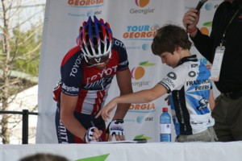
Event Entertainment
Social events are hedonic, with intangible features producing personal pleasure or enjoyment (Holbrook & Hirchman 1982).
Consumers are exposed to promotional messages under favorable conditions where there is enthusiasm, excitement, and enjoyment (Nicholls et al. 1999).
Event attendees form favorable attitudes toward the event when they are engaged (Harvey 2001).
H1: The more entertainment that an attendee derives from the event, the more favorable the attitude will be toward the event.

Slide 14
Activeness in Event Domain
Consumers drawn to events congruent with their lifestyles (Burnett et al. 1993).
Previous research reveals connection between active participation in event and favorable sentiments toward sponsored activities (Meenaghan 2001)
Attendees who feel passion about domain of the event are more likely to hold favorable attitudes toward the event (Close et al. 2006).
H2: The more active an attendee is in the event domain, the more favorable attitude will be toward event.

Slide 15
Sponsor’s Perceived CSR
CSR defined as a firm’s activities and status relative to its societal or stakeholder obligations (Brown & Dacin, 1997)
CSR initiatives may help companies market their products if they have active support from consumers (Maignan & Ferrell 2004); one way to seek active support is via sponsorships of local events that promote healthy lifestyles and benefit charity.
A socially responsible sponsorship holds dual value by achieving marketing objectives while promoting itself as good corporate citizen; can improve attitudes toward the sponsors, clarity about the sponsor’s positioning, and enhance firm equity (Simmons & Becker-Olsen 2006).
H3: More favorable attendee’s attitudes toward event will have positive impact on attendee’s CSR perceptions toward sponsor.

Slide 16
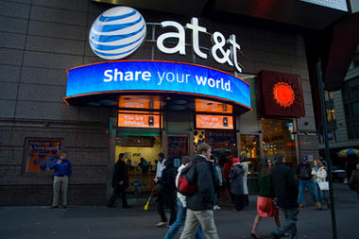
Brand Knowledge
Brand knowledge in sponsorship terms relates to more abstract and intangible brand associations held in minds of consumers about sponsor (Roy & Cornwell 2003).
Consumers’ familiarity with sponsor impacts what they think about the sponsor’s brand when they link the brand to sponsored events (Meenaghan 2001).
Knowledgeable consumers are more engaged with brand and its CSR activities (Algeshheimer et al. 2005).
H4: An attendee’s knowledge of sponsor’s brand will have positive impact on attendee’s CSR perceptions toward sponsor.

Slide 17
Brand Commitment
Consumers need brand knowledge to establish preference for sponsor’s brands (Keller 1993); brand commitment entails preference and reluctance to seek competing brands.
Sponsors benefit from strong CSR perceptions by strengthening consumer’s emotional attachment to the brand (Lichtenstein et al. 2004); consumers may transfer impressions of sponsor’s CSR efforts to commitment to sponsor’s brands.
Sponsored events with a benefactor that resonates with consumers should strengthen brand commitment driven by favorable affective association consumers make about sponsor.
H5: An attendee’s knowledge of sponsor’s brand will strengthen commitment to sponsor’s brand.
H6: An attendee’s CSR perceptions toward sponsor will strengthen commitment to sponsor’s brand.

Slide 18
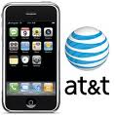
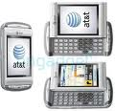
Purchase Intent
In addition to brand commitment, companies sponsor events to elicit variety of consumer responses, including increasing consumers’ willingness to buy the sponsor’s products; CSR initiatives create a corporate context for purchasing decisions (Pirsch et al. 2007).
Further, a company’s efforts directly and indirectly impact consumers’ intentions to purchase its products (Sen & Bhattacharya 2001); positive associations may have indirect effect on purchase intent due to greater commitment to sponsor.
H7: An attendee’s CSR perceptions toward sponsor will increase purchase intent for sponsor’s brand.
H8: An attendee’s commitment to sponsor’s brand will increase purchase intent for sponsor’s brand.

Slide 19
Congruity
Congruity theory help explain consumers’ attitudes when event and sponsor connect; congruity is extent to which consumers’ perceive event and sponsor having similar image, values, and logical connection (Simmons & Becker-Olsen 2006).
Experiments on sponsorship effects show that event-sponsor congruity leads to positive attitudes toward sponsor (Ellen et al. 2000; Rifon et al. 2004); Perceived fit on a key dimension can increase sponsor brand equity and reinforce the sponsor’s positioning (Simmons & Becker-Olsen 2006).
We anticipate that sponsor perceptions rise when attendees’ perceive greater fit with event (H4*-H8*).

Slide 20
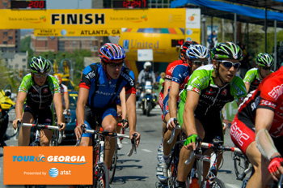
Field Study Research Context
Context to examine: fit, CSR, consumer attitudes and purchase intent
Event: 2007 Tour de Georgia (TDG)
Presenting sponsor: AT&T
Beneficiary: GA Cancer Coalition
As one of the premier cycling races in North America, drew an estimated 515,000 spectators
Generated $27.6 million in direct economic impact to the State of Georgia
AT&T received branding at all venues during race week, pre-event promotions, TDG website, & leader jersey

Slide 21
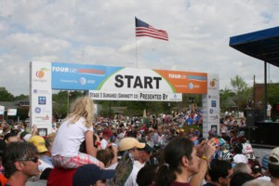
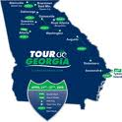
Field Study Method & Sample
Intercept survey during 2007 TDG; surveys were distributed from throughout all 12 TDG host venues
After eliminating incompletes or unreliable surveys n=1,615!
44% are 20-39 years old, 54.9% male
52.8% reported annual household incomes exceeding $60,000; 21% > $100,000
41.4% traveled from another state or country to attend TDG

Slide 22
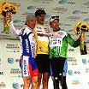
Measurement & Scale Items
All constructs used 5-point Likert-type scales, anchored by 1=strongly disagree/ 5=strongly agree:
Adapted Lichtenstein et al.’s (2004) 5-item scale to measure CSR perceptions
Lumpkin & Darden (1989) provided the 3 measures of Activeness in Event Domain
Chandon et al. (2000) developed the separate 3-item scales used to measure Event Entertainment and Attitude toward the Event
Adapted Bloch et al.’s (1989) 3-item scale to measure Brand Knowledge
Yoo et al. (2000) provided the 3-item scale that measure Brand Commitment
Adapted Baker & Churchill (1977) 4-item scale to measure Purchase Intent
Modified 5-item scale tapping Event-Sponsor Congruity from Speed & Thompson (2000)

Slide 23
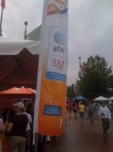
Structural Model Results
Hypothesis
H1: Event Entertainment → Attitude toward Event
H2: Activeness in Event Domain→ Attitude toward Event
H3: Attitude toward Event → Sponsor’s CSR
H4: Brand Knowledge→ Sponsor’s CSR
H5: Brand Knowledge→ Brand Commitment
H6: Sponsor’s CSR → Brand Commitment
H7: Sponsor’s CSR →Purchase Intent
H8: Brand Commitment to Sponsor → Purchase Intent
Structural model results: NFI=.99; NNFI=.99, CFI=.99; IFI=.99, RMSEA=.071; and SRMR=.035 **p < .001
Estimate t-value
.89 42.11**
.10 6.33**
.25 12.41**
.66 27.65**
.49 17.63**
.41 14.72**
.28 14.58**
.72 33.43**

Slide 24
Multi-group Results
High Fit vs. Med Fit vs. High Fit vs.
Med Fit Low Fit Low Fit
2.65 0.09 1.04
0.33 0.01 0.07
0.11 1.59 2.00
0.35 10.87** 16.85**
19.21** 0.90 31.38**
18.15* 3.20 29.07**
17.49** 0.01 9.64*
30.04** 0.37 16.31**
Chi-square Difference Results Among Fit Categories
Event Entertainment → Attitude toward Event
Activeness in Event Domain→ Attitude toward Event
Attitude toward Event → Sponsor’s CSR
H4* Brand Knowledge→ Sponsor’s CSR
H5* Brand Knowledge→ Brand Commitment
H6* Sponsor’s CSR → Brand Commitment
H7* Sponsor’s CSR →Purchase Intent
H8* Brand Commitment to Sponsor → Purchase Intent
High Fit mean=4.81, n=649; Med Fit mean=3.51, n=613; Low Fit mean=1.78, n=353 1 degree of freedom comparison *p<.01; **p<.001

Slide 25
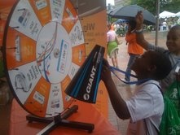
Discussion
The study provides real-world evidence how CSR serves as consumer attitudinal linkage between event and sponsor.
Results make it clear consumers’ attitudes toward event directly influence their assessments of sponsor’s CSR, which, in turn, strengthens (a) feelings of commitment to sponsor’s brand and (b) their intentions to purchase sponsor’s products.
Results show congruity plays role in consumers’ perceptions of sponsor brand and intentions to use those brands
Yet fit doesn’t necessarily influence their evaluation of events, especially when they already have positive attitudes toward the event.

Slide 26
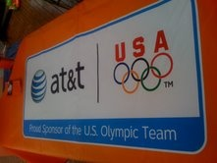
Discussion – cont.
Consumers maintain harmony in their assessments of a company’s sponsorship activities and how it demonstrates CSR.
When consumers have high brand knowledge and perceive a high event-sponsor fit, they are more likely to hold higher CSR perceptions and be more committed to sponsor’s brand.
Similarly, when consumers perceive that a company is socially responsible and that there is high event-sponsor fit, they are more likely to be committed to the sponsor’s brand and have higher purchase intentions toward sponsor’s products.
Model’s framework helps move us toward a better understanding of how companies may use event sponsorship to strengthen CSR perceptions.

Slide 27
References
Algesheimer, R., U.M. Dholakia, and A. Herrmann (2005), “The Social Influence of Brand Community: Evidence from European Car Clubs,” Journal of Marketing, 69 (July), 19-34.
Baker, M.J. and G.A. Churchill, Jr. (1977), “The Impact of Physically Attractive Models on Advertising Evaluations,” Journal of Marketing Research, 14 (4) 538-55.
Bloch, P.H., D.L. Sherrell, and N.M. Ridgway (1989), “Product Knowledge Scale.” In Marketing Scales Handbook: A Compilation of Multi-item Measures, G. Bruner, II and P. Hensel, eds. Chicago: American Marketing Association 1, 440-1.
Brown, T. and P.A. Dacin, (1997), “The Company and the Product: Corporate Associations and Consumer Product Responses’,” Journal of Marketing 41(May): 68-84.
Burnett, J., A. Menon, and D.T. Smart (1993), Sports Marketing: a New Ball Game with New Rules, Journal of Advertising Research, (September/October), 21-35.
Chandon, P., B. Wansink, and G. Laurent (2000), “A Benefit Congruity Framework of Sales Promotion Effectiveness,” Journal of Marketing, 64 (4), 65-81.
Close A.G., R.Z. Finney, R. Lacey, and J.Z. Sneath (2006), “Engaging the Consumer Through Event Marketing: Linking Attendees With the Sponsor, Community, and Event,” Journal of Advertising Research, 46 (December), 420-33.
Harvey, B. (2001), “Measuring the Effects of Sponsorships,” Journal of Advertising Research, 41 (February), 59-65.
Holbrook, M.B. and E. C. Hirschman (1982), “The Experiential Aspects of Consumption: Consumer Fantasies, Feelings and Fun,” Journal of Consumer Research, 9 (September), 132-40.
Keller, K.L. (2003), “Brand Synthesis: The Multidimensionality of Brand Knowledge,” Journal of Consumer Research, 29 (March), 595-600.
Keller, K.L. (1993), “Conceptualizing, Measuring, and Managing Customer-Based Brand Equity,” Journal of Marketing, 57 (January), 1-22.

Slide 28
References
Lichtenstein, D.R., M.E. Drumwright, and B.M. Braig (2004), “The Effect of Corporate Social Responsibility on Customer Donations to Corporate-Supported Nonprofits, Journal of Marketing, 68 (4), 16-32.
Lumpkin J.R. and Darden, W.R. (1989), “Sports Activeness Scale.” In Marketing Scales Handbook: A Compilation of Multi-item Measures, G. Bruner II and P Hensel, eds., Chicago: American Marketing Association, 576-7.
Maignan, I. and O.C. Ferrell (2004), “Corporate Social Responsibility and Marketing: An Integrative Framework,” Academy of Marketing Science, 32 (1), 3-19.
Meenaghan T. (2001), “Understanding Sponsorship Effects,” Psychology & Marketing, 18 (February), 95-122.
Nicholls, J.A.F., S. Roslow, and S. Dublish (1999), “Brand Recall and Brand Preference at Sponsored Golf and Tennis Tournaments,” European Journal of Marketing, 33 (3/4), 365-86.
Pirsch, J.. S. Gupta, and S. Landreth Grau (2007), “A Framework for Understanding Corporate Social Responsibility Programs as a Continuum: An Exploratory Study,” Journal of Business Ethics, 70, 125-40.
Rifon, N.J., S.M. Choi, C.S. Trimble, and H. Li (2004),” Congruent Effects of Sponsorship: The Mediating Role of Sponsor Credibility and Consumer Attributions on Sponsor Motive,” Journal of Advertising, 33 (Spring), 29-44.
Roy, D.P. and B.T. Cornwell (2003), “Brand Equity’s Influence on Responses to Event Sponsorship,” Journal of Product and Brand Management, 12 (6), 377–93.
Sen, S. and C.B. Bhattacharya (2001), “Does Doing Good Always Lead to Doing Better? Consumer Reactions to Corporate Social Responsibility,” Journal of Marketing Research, 38 (May), 225-43.
Simmons, C.J. and K.L. Becker-Olsen (2006), “Achieving Marketing Objectives Through Social Sponsorships,” Journal of Marketing, 70 (October), 154-69.
Speed, R. and P. Thompson (2000), “Determinants of Sports Sponsorship Response,” Journal of the Academy of Marketing Science, 28 (2), 226-38.
Yoo, B., N. Donthu, and S. Lee (2000). “An Examination of Selected Marketing Mix Elements and Brand Equity,” Journal of the Academy of Marketing Science. 28 (April), 195-211.

