Slide 1
PROMOTION and other out of home tools.
Professor Close and Professor Dudo

Slide 2
Promotions
Directories
Magazines
Internet
TV
Billboards
Transit
Radio
Branded entertainment
Notes:
It’s time for us to consider the placement stage of ADV and IBP

Slide 3
SALES PROMOTION
Increasing the value of a product by offering an extra incentive to purchase the product
3 types of sales promotions: consumer, trade, and sales force
Notes:
We focus on consumer today.

Slide 4
IMPORTANCE OF SALES PROMOTION
1980s – 60% ADV / 40% promotion flip-flops
~2000 – switches back
Now – allocation is about equal
$100 billion plus industry w/ a steady growth rate

Slide 5
WHY THE SHIFT?...
1. More pressure for short-term profits
2. Increased need for accountability
3. Cheaper than trad media
4. Easy and quick to measure effectiveness
5. Consumer behavior is more sophisticated/fickle
6. Consumers expect short-term price reductions
7. Can combat parity
8. Retailers wield more power

Slide 6
OBJECTIVES OF SALES PROMOTION
1. Stimulate trial purchase
2. Stimulate repeat purchases
3. Stimulate larger purchases
4. Introduce a new brand
5. Combat or disrupt competitors
6. Contribute to IBP

Slide 7
SALES PROMOTION VS. ADVERTISING
PROMOTION | ADVERTISING
Creates immediate action | Cultivates long-term brand image
Adds tangible value to the product | Adds intangible value to the product
Short-term profits | Long-term profits
Encourages brand switching | Encourages brand loyalty
Produced easily measured results | Results are more difficult to measure
Encourages trial use | Encourages repeat purchase
Anthony Dudo ©
Notes:
In general, promotion is focused on action while advertising is more subtle (focused on awareness).

Slide 8
SALES PROMOTION TECHNIQUES
Coupons
Price-off deals
Sampling
Rebates / refunds
Contests / sweepstakes
Premiums
Specialties
Frequency programs
Value packs
Anthony Dudo ©

Slide 9
PULL STRATEGY
Consumers ask resellers to provide certain products
By asking for these products they are “pulled” through the distribution channel
Manufacturer
Reseller
Consumer
Demand starts here
Notes:
When we talk about sales promotions focused on consumers, we’re dealing with the pull strategy.
The sales promotions are targeted at the consumer – the goal is to get them to demand the product from resellers.

Slide 10
COUPONS
Entitle a buyer to a price reduction for a product or service
ADVANTAGES | DISADVANTAGES
Incentivizes sensitive customers | Time of redemption cannot be controlled
Induces brand switching | Coupon programs require costly administration
Timing/distribution can be controlled | Coupon fraud
Stimulates repeat purchases
Gets regular users to trade-up

Slide 11
PRICE-OFF DEALS
Offering consumers a reduced price at point of purchase through specially marked packages
ADVANTAGES | DISADVANTAGES
Is controllable by manufacturer | Retailers belief it creates inventory and pricing problems
Creates positive price comparisons
Increases consumer’s belief in the value of a known brand
Anthony Dudo ©

Slide 12
SAMPLING
Giving a consumer an opportunity to use a brand on a trial basis with little or no risk
Types of sampling:
In store
Door-to-door
Mail
Newspaper
On package
Mobile

Slide 13
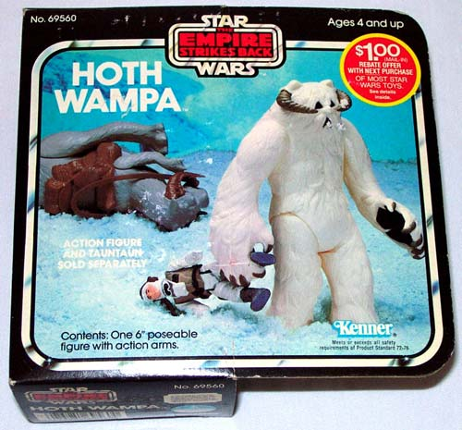
REBATES / REFUNDS
Manufacturer’s offer to return a certain amount of money to the consumer who purchases a product
Why do this? …
Many consumer fail
to redeem the
rebate

Slide 14
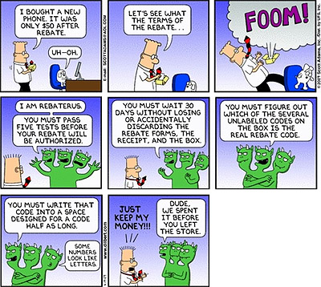
REBATES / REFUNDS
Anthony Dudo ©

Slide 15
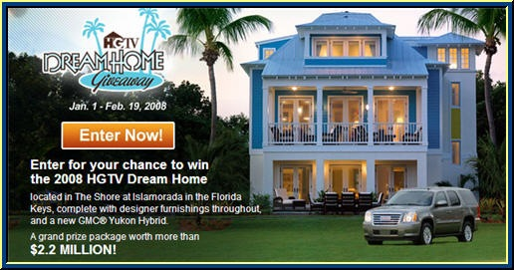
CONTESTS & SWEEPSTAKES
Contests: consumers compete for prizes based on skill or ability
Sweepstakes: winners picked by chance

Slide 16
CONTESTS & SWEEPSTAKES
ADVANTAGES | DISADVANTAGES
Create excitement & interest | Consumers may focus on the game rather than the brand
 | Game mentality obscures IBP messages
 | Complex legal and regulatory requirements

Slide 17
CONTESTS & SWEEPSTAKES
1. No purchase is necessary
2. Start and end dates
3. Eligibility requirements
4. Method of entry
5. Entry limitations
6. Odds of winning
7. Description/value of prizes
8. How the winner(s) will be selected and notified
9. Restrictions on receiving the prize
10. Sponsor’s name and address
11. Official rules cannot change
Notes:
Sweepstakes can get messy fast!!!

Slide 18
PREMIUMS
Free or reduced price for an item with the purchase of another item or particular act
Two types: direct and mail
Direct premiums include:
Store premiums
In-pack premiums
On-pack premiums
Container premiums

Slide 19
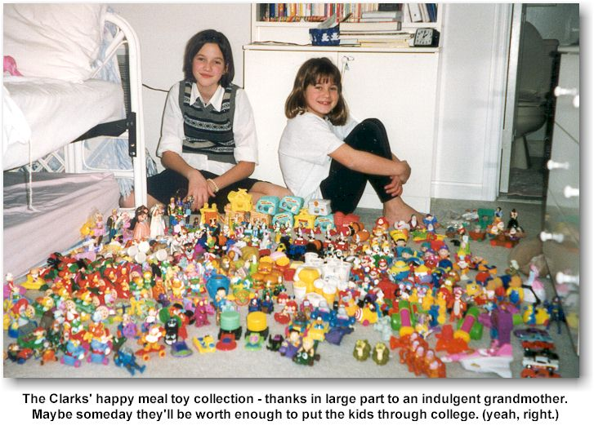
IN-PACK PREMIUMS
Anthony Dudo ©

Slide 20
IN-PACK PREMIUMS
Anthony Dudo ©

Slide 21
SPECIALTIES
Message is placed on a item that is given away for free
Similar to a premium but the consumer does not need to purchase anything
Ideally, the item will remain publicly visible

Slide 22
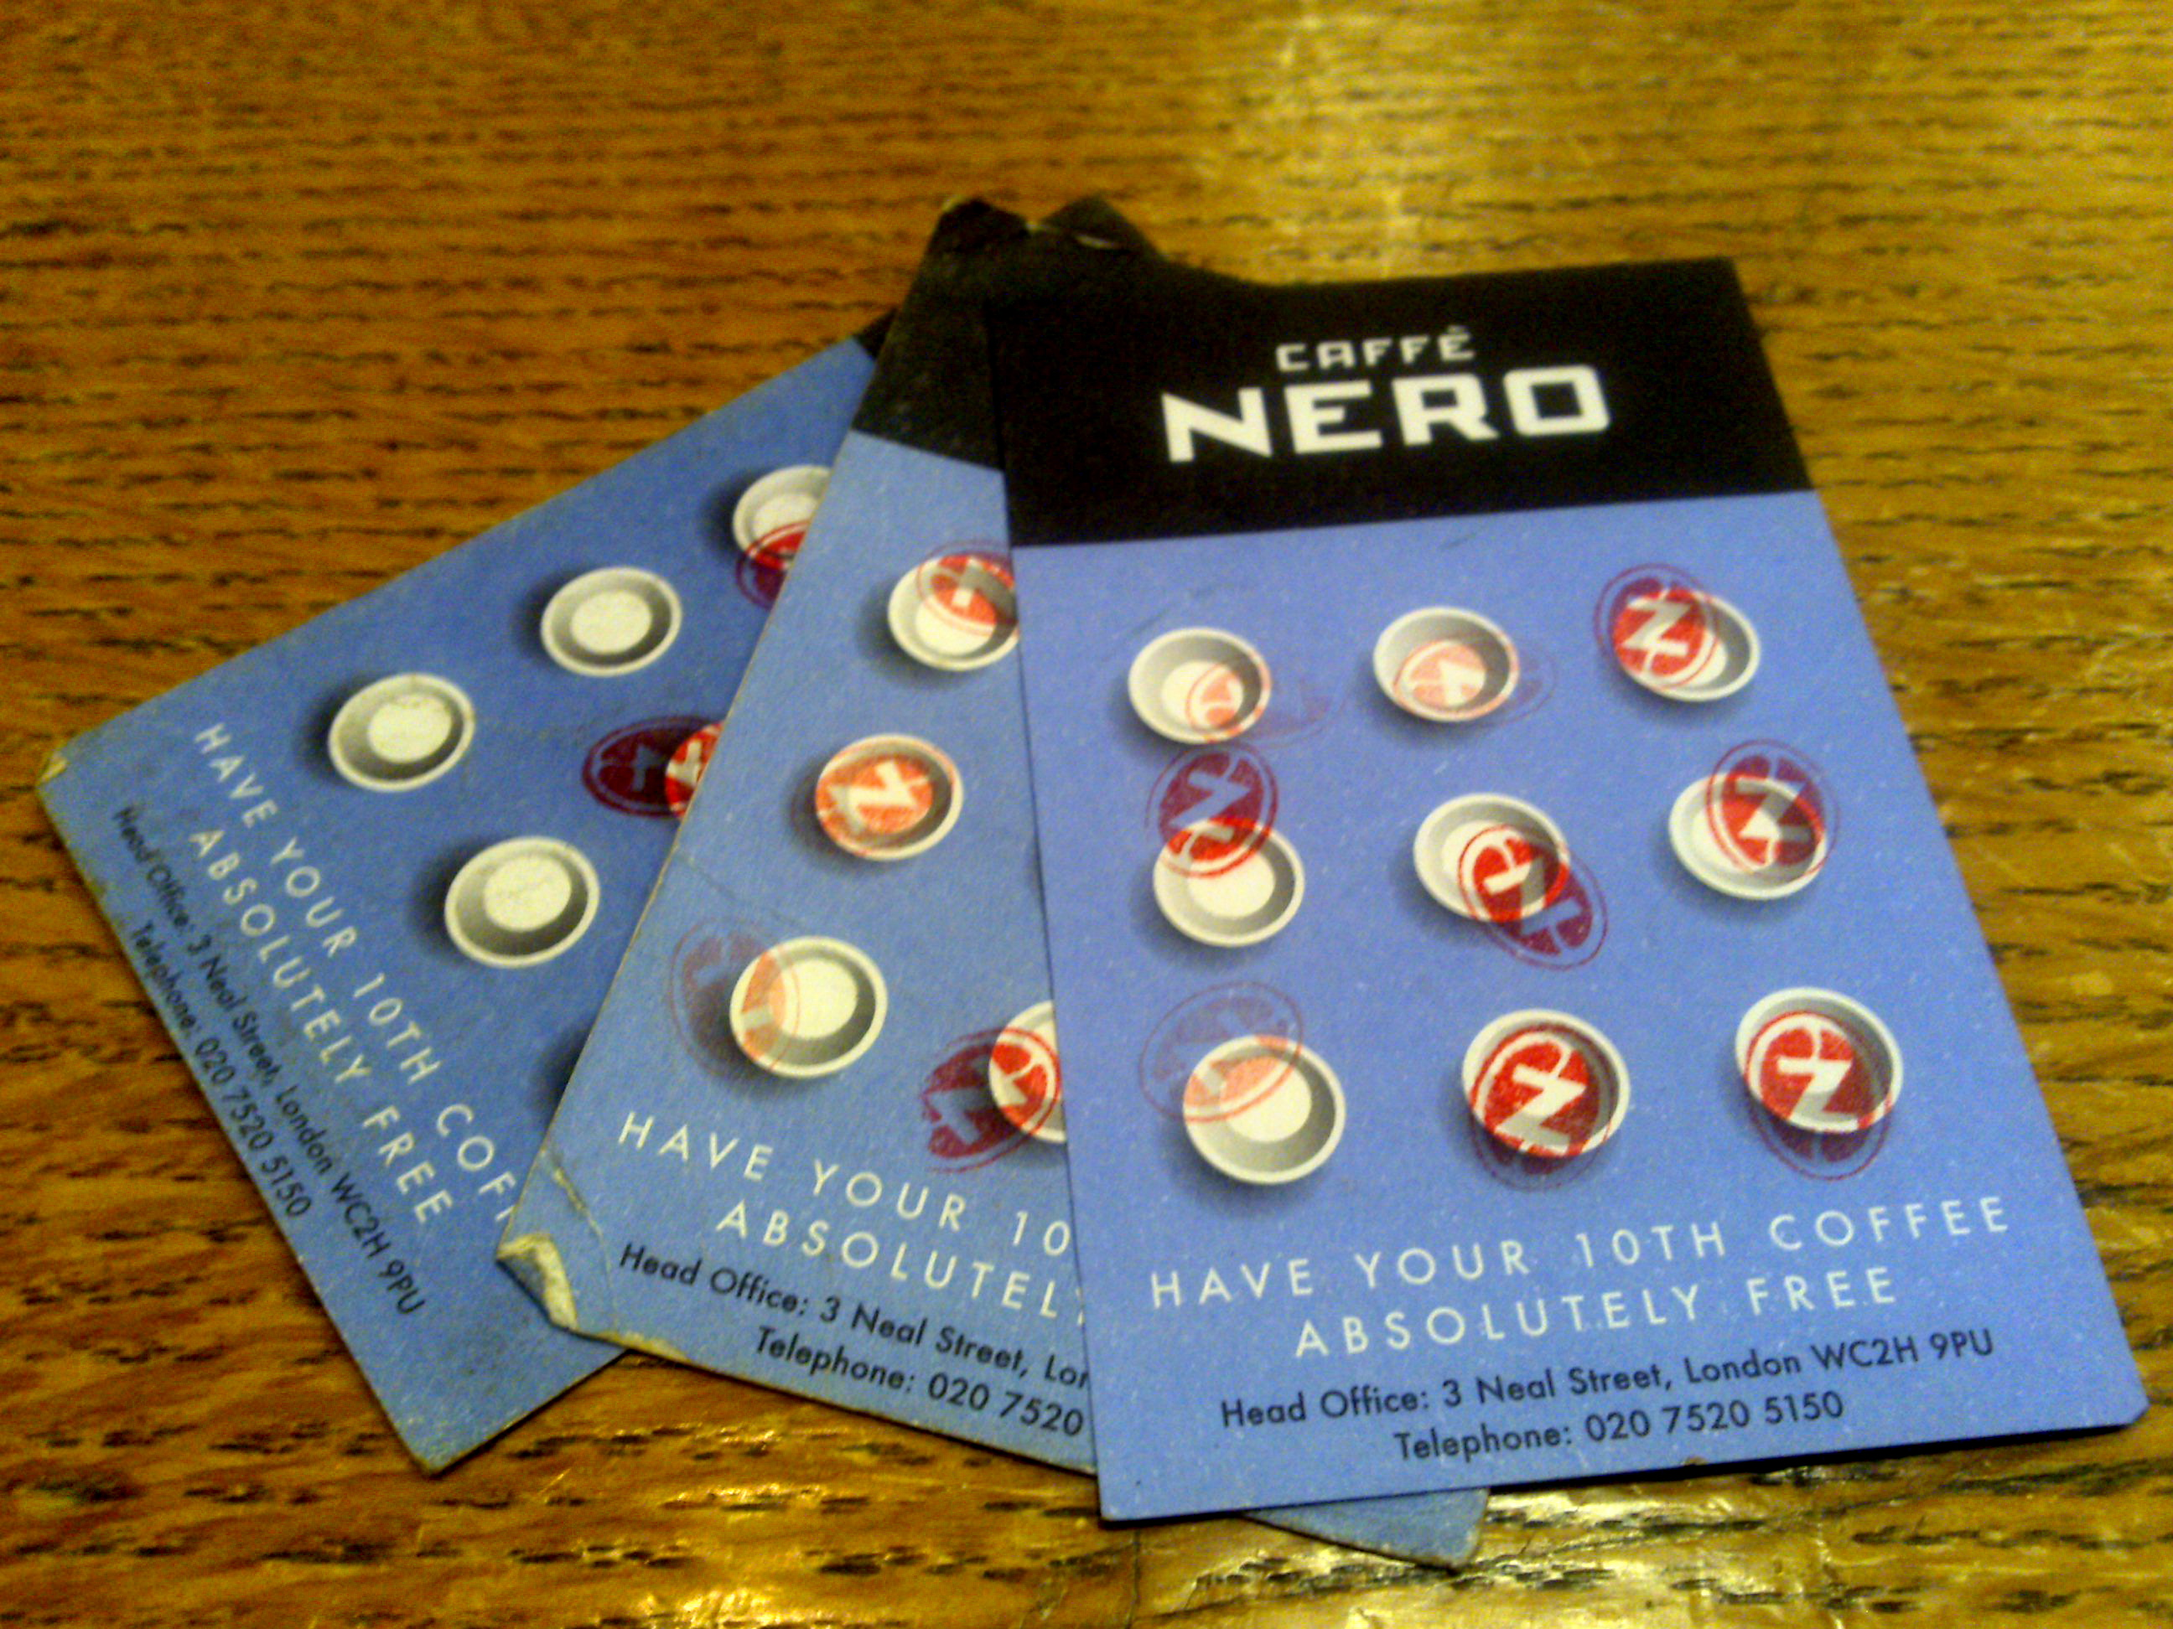
FREQUENCY PROGRAMS
Offer customers discounts or free products for repeat patronage
Also known as “continuity programs”
Common in the airline, travel, and restaurant businesses
Anthony Dudo ©

Slide 23
RISKS OF SALES PROMOTION
Creates a focus on price instead of product
- deal price becomes expected price
- fuels promotion wars
Do little to build customer loyalty
Invites abuse (e.g., coupon misredemption)
May not stimulate repeat purchases
Alienates customers
Logistical and legal considerations
Anthony Dudo ©

Slide 24
PUSH STRATEGY
Demand starts here
Manufacturer convinces members of the distribution network to carry and market the product by rewarding them
Incentivizing the resellers “pushes” the product through the distribution channel to the consumers
Manufacturer
Reseller
Consumer
Notes:
When we talk about trade promotions, we’re dealing with the push strategy.

Slide 25
SALES PROMOTION FOCUSED ON TRADE
Objectives:
Obtain initial distribution
Increase order size
Increase store traffic
See trade-market sales promotion techniques in textbook

Slide 26
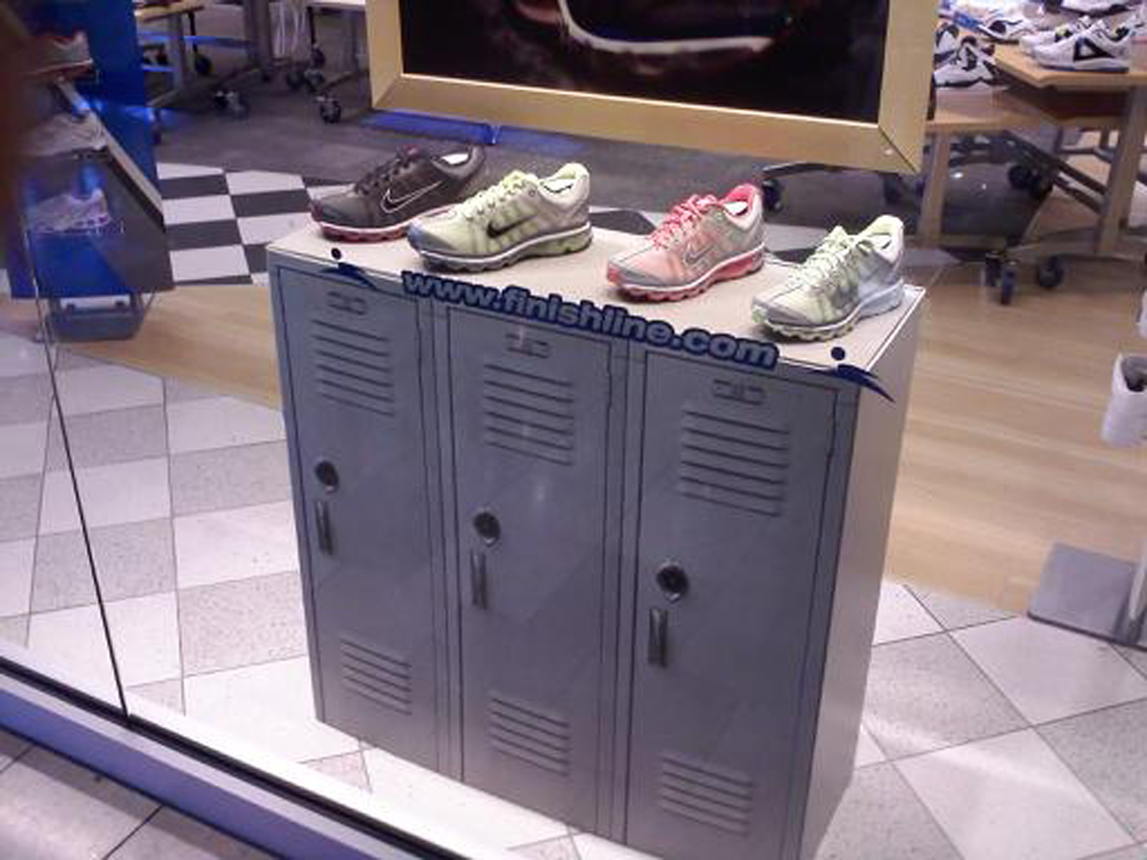
POINT-OF-PURCHASE (P-O-P) ADV
Materials used in the retail setting to attract shoppers’ attention to a brand, to convey primary product benefits, or highlight pricing information
Objectives:
- Draw consumer attention
at retail
- Simulate trial use from
new users
- Encourage resellers to carry
brand

Slide 27
COORDINATION CHALLENGE
How can sales promotion be successfully integrated into the larger IBP picture? …
Must coordinate the use of ADV and sales promotion
- e.g., advertising creates awareness and promos induce a trial
Poorly conceived promos can hurt a brand

