Slide 1
Beginning of Part 2 The Planning: Analyzing the Advertising & Integrated Brand Promotion Environment
We have finished the Process phase of the text & moving on to Planning
Our perspective changes from a broad view of advertising to a managerial view
The Planning phase leads to the development of advertising materials

Slide 2
5
Advertising & Consumer Behavior

Slide 3
Consumer Behavior
Consumer Behavior: a wide spectrum of things that affect, derive from, or form the context of human consumption.
Perspectives:
Consumers are Systematic decision makers
Maximizing the benefits from purchases defines the purchase—consumers are deliberate
Consumers are Active Interpreters
Cultural/social membership defines purchases
Gender matters

Slide 6
The consumer decision-making process
Need recognition
--Functional or Emotional benefits
Information Search & Evaluation
--Internal & External search
--Consideration Set
--Evaluative Criteria
Purchase
4. Post-purchase use & evaluation
Customer satisfaction
Cognitive dissonance

Slide 7
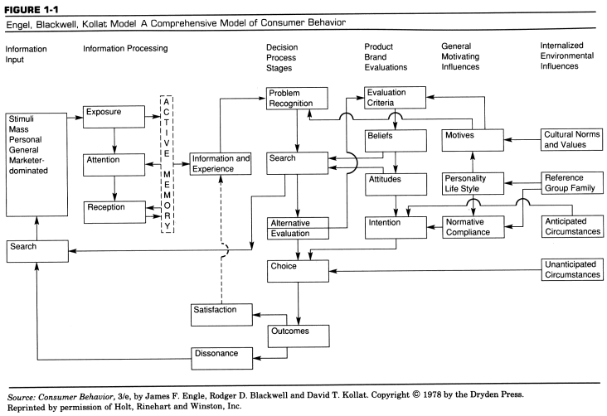

Slide 8
Cognitive Dissonance
The feelings of doubt & concern after a purchase is made. Dissonance increases when
The purchase price is high
There are many close alternatives
The item is intangible (example?)
The purchase in important
The item purchased lasts a long time

Slide 9
Cognitive Dissonance
Cognitive dissonance refers to a situation involving conflicting attitudes, beliefs or behaviors. This produces a feeling of discomfort leading to an alteration in one of the attitudes, beliefs or behaviors to reduce the discomfort and restore balance. For example, when people gamble (behavior) and they know that the odds are against them (cognition).
Festinger's (1957) theory suggests that we have an inner drive to hold all our attitudes and beliefs in harmony & avoid disharmony (or dissonance).

Slide 10
Cognitive Dissonance
Attitudes may change because of factors within the person. An important factor here is the principle of cognitive consistency; we seek consistency in our beliefs and attitudes in any situation where cognitions are inconsistent.
A powerful motive to maintain cognitive consistency can give rise to irrational and sometimes maladaptive behavior. We hold many cognitions about the world and ourselves; when they clash, a discrepancy is evoked, resulting in a state of tension known as cognitive dissonance. As the experience of dissonance is unpleasant, we are motivated to reduce or eliminate it, and achieve consonance (i.e. agreement).

Slide 11
Modes of Consumer Decision-Making: (Vary by involvement & experience)
Extended Problem Solving
Deliberate, careful search
Limited Problem Solving
Common products, limited search
3. Habit or Variety Seeking
Variety seeking—switch brands at random
Habit—buy single brand repeatedly
4. Brand Loyalty
Conscious commitment to find same brand each time purchase is made

Slide 12
Are you brand loyal to a softdrink?

Slide 13
Key Psychological Processes in Advertising
Attitude
-- Overall evaluation of an object person or issue on continuum=like/dislike; positive/negative
Brand Attitude
Summary evaluations that reflect preferences for various products & services
Salient Beliefs
Small number of key beliefs. Five to nine salient beliefs typically form the critical determinants of attitude

Slide 14
Key Psychological Processes
Multi-Attribute Models (MAAMs)
Evaluative Criteria: attributes consumers use to compare brands
Importance Weights: priority assigned to attributes
Consideration Set: group of brands that are focal point of decision effort
Beliefs: knowledge & feelings consumer has about various brands.

Slide 15
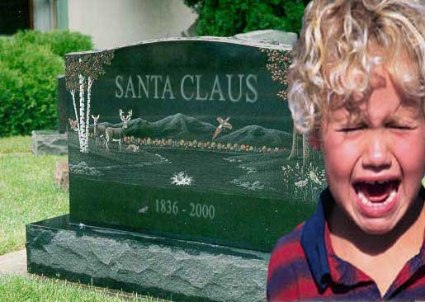
We Want to Believe!

Slide 16
Key Psychological Processes
Information Processing & Perceptual Defense
Cognitive Consistency Impetus: Strongly held beliefs to make efficient decisions
Advertising Clutter: Large volume of ads causes overload
Cognitive responses: Thoughts that occur to consumer at moment when beliefs are challenged by persuasive communication

Slide 17
Key Psychological Processes
The Elaboration Likelihood Model (ELM)
Central route persuasion in high involvement products
Peripheral cues rather than strong arguments shape attitudes in low-involvement products

Slide 18
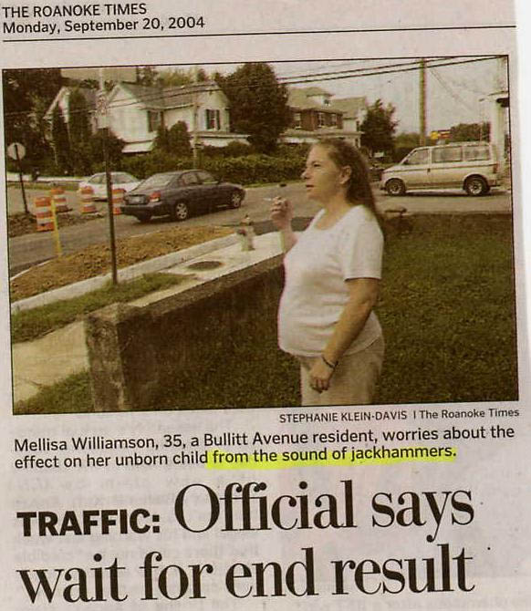
Persuasion is Hard with Routine Behaviors.

Slide 19
Advertising as Social Text: How Ads Transmit Sociocultural Meaning
Culturally constituted world
Advertising /
fashion system
Fashion
system
Consumer goods
Possession
ritual
Exchange
ritual
Grooming
ritual
Divestment
ritual
Individual consumer

Slide 20
Factors Impacting Consumer Decision Making
REFERENCE
GROUPS
VALUES / ATTITUDES
CULTURE
SITUATIONAL
FACTORS
NEEDS
CONSUMER
DECISIONS
EDUCATION
PLEASURE
PERSONALITY
GENDER
MARKETER-
CONTROLLED
STIMULI
FAMILY
MEDIA
SOCIAL
CLASS
NEWS
MAGAZINES
RADIO
TELEVISION
DIRECT MEDIA
PAST
EXPERIENCE
PRICE
PACKAGING
ADVERTISING
PROMOTION
PERSONAL SELLING
LIFE-STYLE
SUBCULTURES

