Slide 1
1 An Overview of Marketing
Marketing’s Value to Consumers,
Firms & Society
Dr. Close

Slide 2
Objectives
Explain exactly what marketing is….
Talk about the components of marketing exchange
Review history of marketing and management philosophies
Discuss the importance of marketing

Slide 3
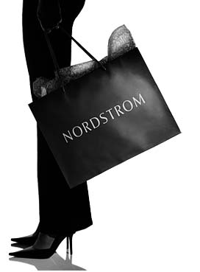
Some Ideas of Marketing
Traditional Approach
Selling & Advertising (one part)
What else?
Customer Satisfaction
What do you think it means? Are there any examples where you were really satisfied or not satisfied?
Examples: Nordstrom, Southwest Air
Marketing requires 2 or more capable parties to trade items of value. Each party may deal with the other…either accept or reject the exchange offer
Marketing’s job is NOT to get rid of things produced by the firm, it is to build relationships

Slide 4
Southwest Airlines Reaching out to Customers

Slide 5
Marketing Defined
“An organizational function and a set of processes for creating, communicating, and delivering value to customers and for managing customer relationships in ways that benefit the organization and its stakeholders” (AMA)
Everything we do to get and keep a customer
Begins with the customer
Series of sales or exchanges….a relationship

Slide 6
History of Marketing: Management Philosophies
Evolution of marketing orientations:
Simple trade orientation (trading of simple goods)
Production orientation (Industrial evolution)
Sales orientation (emphasis on selling because of competition)
Marketing department orientation (when all marketing activities are under the control of one department)
Marketing company orientation (involves short and long run planning)
~Apple, Nike, Coke, BMW, VW, Wynn, Palms

Slide 7
Importance of Marketing
Everyone needs it! (politicians, churches, resumes)
What if marketing (e.g., ads, brands) did not exist? How would your life be different in these ways?
Your favorite (and not so favorite) local and global businesses that you depend on? (my crackberry…)
Your shopping?
Your events/social life?
Your education in this (fabulous) class?
Your career?
Your every day life?
…what if we lived like Thoreau’s character in Walden Pond…

Slide 8
Marketing & Society (1)
Macro-Marketing:
directing flow of goods/services to us in a way that…
Accomplishes a society’s objectives (whatever those may be: capitalism, democracy…easy to take for granted)
Trends toward market direction, not regulation (phone)
Sometimes we get irritated and upset with businesses and service providers, but don’t they overall they set out to make our lives better?
(if they are savvy, well-run, thinking long term)
Matches supply and demand (e-bay: brilliant?)

Slide 9
eBay…What are your experiences? How will this e-market shift society?

Slide 10
Marketing & Society (2)
What about society/ our well-being?
(Google Prof. Joe Sirgy for research on this…)
Micro-macro dilemma: “What is good for the individual (or company) may not be good for society.”
Difficult questions (health care,
marketing to children, tobacco, fast food)
My student’s dilema…
Be true to yourself.

Slide 11
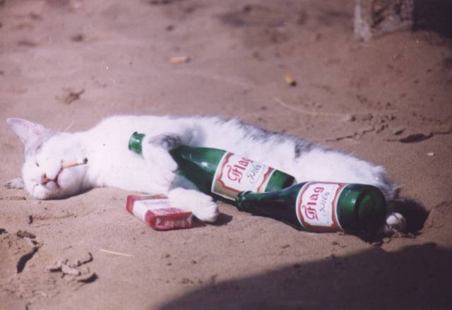
Marketing & Society (3)
Meet Terrance. (my cat in Georgia; in Vegas)
Vices are marketed and distributed everywhere (ok, so we live in Vegas…)
Should they not be? (does marketing and business make you do/buy unwanted things?

Slide 12
Marketing & Society (3)
Let’s debate the “Quality” issues of the system…
One side…marketing hinders lifestyles
Resist the market! some say
Issues scholars or anti-business or marketing types raise…
Rich benefit vs. poor
Marketing is misleading; sometimes intentionally
Privacy is poor
Credit causes indebtedness
What other of such arguments can you think of?

Slide 13
Questions about Marketing
Let’s debate the “Quality” issues of the system…
Another side…Marketing enhances our lives
Issues scholars or market proponents raise:
Connects people (American Idol, Iraqi Idol)
Innovation
Efficiency (imagine grocery shopping without brands)
Helps build relationships
Provides entertainment, escape
Enhances competition
Provides choice/individualism opportunities
What other good things do you see with marketing?

Slide 14
Summary
What is marketing?
Marketing management philosophies
Societal marketing
Individuals view marketing differently
Any other questions?

