Slide 1
blog…blog…blog
Insights in emarketing, Professor Close
Technology is CRUCIAL to effective marketing!
So, how do we use blogs and eWOM (electronic Word of mouth)?
CMC (computer-mediated-communication) is vastly different…
Marketing communication is changing rapidly (I’ll text you the details LOL;) !!!
Say goodbye to traditional TV advertising as we know it (it is not interactive enough)
If you don’t like what I am saying, just TiVo me and fast forward during the dull parts…

Slide 2
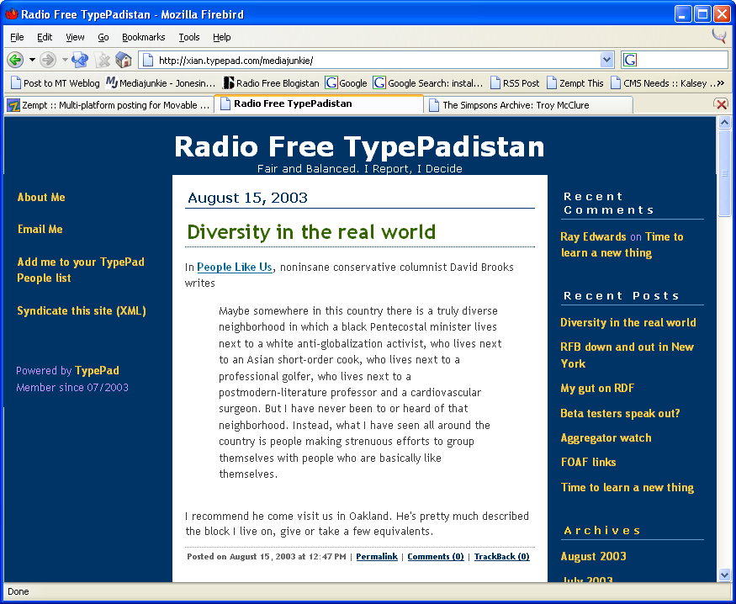
Designing and Building blogs
Insights in blog design and building
By Christian Crumlish

Slide 3
What This is Not About
How to develop custom weblog software
Enterprise content management solutions
How to make money from a weblog
Website visual design
Bulletin board systems, chat, IM
Politics/personalities

Slide 4
Weblog Acronyms and Jargon
CMS - content management system
RSS - really simple syndication
OPML - outline processor markup language
Aggregator - An application for reading syndicated feeds
Entry - a weblog post or item
Feed - A machine-readable list of recent weblor or news items
Blog - weblog
Blogosphere - weblogs taken as a whole, as a community of discourse
Blogistan - same as above

Slide 5
Weblog Acronyms and Jargon (cont’d)
Blogroll - A list of recommended weblog links
Bookmarklet - A bookmark-with-script (used for posting an entry to a weblog based on the current browser page)
Trackback - a weblog entry commenting on another (and notifying the original entry)
Permalink - a link to the permanent archive of a weblog entry
Ping - a message sent from one web host to another
Syndication - Distributing headlines, excerpts, or full-text items for consumption by aggregators

Slide 6
What’s the Big Deal?
Getting beyond the hype

Slide 7
Do Blogs Matter?
Fad hides a meaningful trend
Deceptively simple
Index/archive/database
Extremely easy to maintain
Frictionless web updates
Personal publishing
Writable web
This was always the vision of the web
The web is a two-way communications medium
OR actually it’s many-to-many
Google loves blogs
Bloggers pre-digest the web
Virtuous cycle feedback loops

Slide 8
Uses for Blogs
Enhancing personal brand
A streamlined content management solution for websites
Refreshing a site with news, updates
Generating community, buzz
Nanopublishing
Knowledge capture (outboard brain)

Slide 9
What Makes a Blog a Blog?
The essence of a blog is a regularly updated website with the newest information at the top.
Information over a certain age (often a day or a week) disappears from the home page but remains accessible at a permanent address (an archive).
Culturally, epitomized by sites featuring the “unedited voice of person.”
Logging
The idea of logging, journaling, etc., goes way back. People point to Doug Engelbart’s work at what is now the Stanford Research Center (where the once-modern windows-icon-menu-pointer (wimp) interface was developed on a team journaling system called Augment as one of the precursors of today’s blogging phenomenon.

Slide 10
Types of Weblogs
Links-and-commentary
Diary/journal
Long-form essays/punditry
“What’s New” page
Photoblog
Moblog
Quick Links
K-log

Slide 11
Are We Stuck with the Word ‘Blog’?
It looks ugly and sounds funny.
The novelty wears off quickly
In the meantime people think you said “blob.”
The name is probably here to stay, thanks to Pyra and their Blogger software.
You’ll look like a rube if you spell it ’blog or, worse, if you pronounce it “bee-log.”
Blog, it should be noted, is both a noun and a verb.
A weblog is a blog, but to blog generally means to write an entry in a blog (about), as in “Cool site! I just blogged it” or “I’m going to blog this when I get home.”
Blog Usage
Some people use blog to mean personal weblog as distinct from one that’s more link-oriented, but most use it to mean any kind of weblog or any site containing a blog or just the blog part of a site or any page containing a blog or just the blog part of the page.

Slide 12
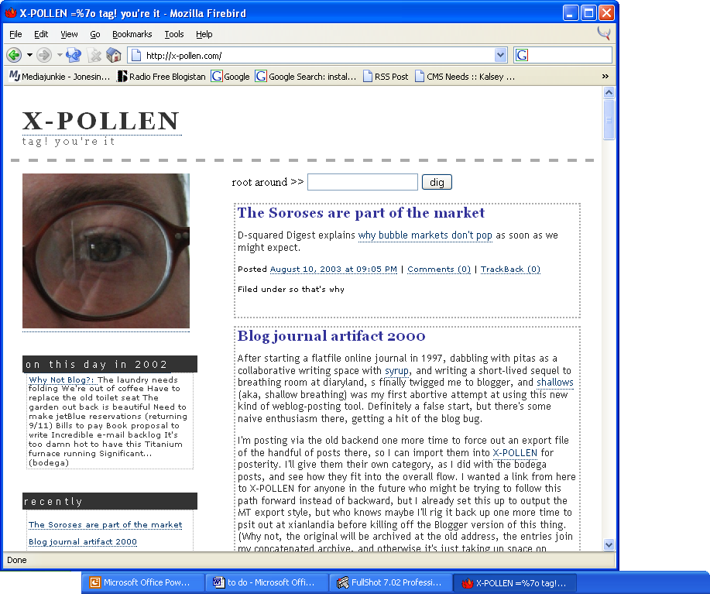
Anatomy of a Weblog
Moving Parts

Slide 13
Anatomy of a Weblog
Banner (usually)
Main content area
Recent entries, most recent first
Entries grouped by date
Sidebar
About the Author
Navigation
Links

Slide 14
Anatomy of a Weblog Entry
Title (usually)
Link (sometimes)
Entry text
Permalink (usually)
Datestamp
Links for comments and or trackbacks (sometimes)

Slide 15
Permalinks
One problem with the rolling of old entries off the home page of a blog is that it can make linking to an item tricky.
Do you link to the home page? If so, eventually your link stops making sense. Also, in the meantime, readers may have to scroll down to find the entry once newer ones are posted at the top of the page.
What greases the wheels of blogging is ease-of-use, not stop-and-think or hey-this-is-a-hassle-forget-it. The solution is the permalink—that is, a permanent link to an entry.
If you’ve ever wondered why some blogs have the word “link” or “permalink” or sometime a hashmark (“#”) after each entry, but clicking the link just takes you to that same post, well this is why.
Anyone who wants to link to the item can use the unique URL of the permalink instead of a generic link to the home page. (After all, the home page link only makes sense, really, when you’re recommending the blog as a good read in general.)
Most blog software generates permalinks automatically.

Slide 16
Blogrolls
Another common, but not mandatory, characteristic of weblogs is the (relatively) static sidebar running alongside the tall column of posted entries.
Frequently updated content solves a lot of web problems but it doesn’t really address the need for more stable, organized information.
When Cameron Barrett started listing “other websites like this one” at his popular early weblog site CamWorld (http://camworld.com/), he set in motion a tradition of using the sidebar of one’s blog to list other sites you recommend and presumably read yourself.
Such a lists of links is now usually called a blogroll (named after the habit authors have of blurbing each other’s books, which is called logrolling).
Not Permalinks You will sometimes hear people refer to the stable links in the sidebar of a blog as permalinks. This is an understandable mistake. They’re links aren’t they? And they sit there permanently instead of scrolling off the page like a blog post, right? True, but as we’ve seen that word is already taken

Slide 17
Other Common Features
“What I’m reading” or “What I’m listening to” lists, sometimes with book or album covers, sometimes as links to Amazon or another store that earns a tiny affiliate commission.
Tip jar
Wish lists (lists at Amazon or elsewhere of items you’d like that others can buy you)
Swag stores (often using Café Press) selling t-shirts, trucker caps, and coffee mugs with the blog’s logo or slogan on it (seriously)!

Slide 18
A Flexible Concept
Deep down, the "log" concept is pretty flexible.
You can keep track of or publish anything in chronological order.
There are some stunning photoblogs out there.
The idea of what constitutes a blog is still evolving.
As people influence each other and catchy ideas catch on, the elements of blogging will change and blogs themselves will eventually evolve into something else as technology and culture continue to interact with each other.

Slide 19
Variant Types of Blogs
The blog model is flexible, and can be stretched in many ways to accommodate various interpretations, as long as the "log" aspect is there.
Inside companies you may see project blogs or knowledge logs
There are professional blogs
We’re starting to see more paid journalist / columnist / pundit-type blogs,
There are nanopublishing ventures, such as Nick Denton’s Gizmodo, a blog that features electronic gadgets as a commercial venture, and the Gawker, a media/gossip magazine.

Slide 20
Multiauthor Blogs
A blog does not have to be written by just one person.
There are any number of group blogs (several blog software tools make team blogging a snap), including some very popular community weblogs (not usually called blog in this case), such as Metafilter.com, Kuro5hin.org, and Slashdot.org.
There are people extending the blog architecture to drive entire edited, multicontributor publications, such as The Morning News (http://themorningnews.org/).

Slide 21
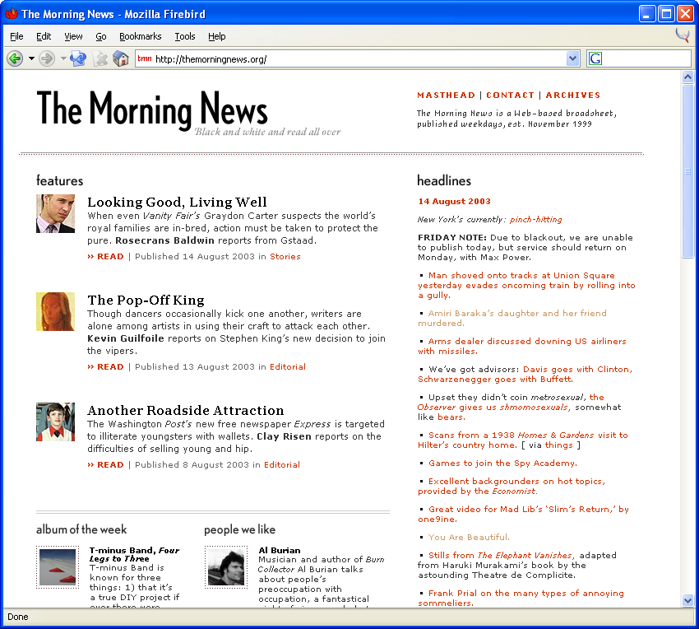

Slide 22
Authentic Voice
Blogging works chiefly because it is easy and fast.
This means that the owner of a blog has few if any impediments to updating the site frequently whenever anything meaningful or useful comes to mind.
This also means that the reader of a blog is rewarded with current, up-to-date information provided in a fluid format.
Because of this close-to-the-microphone context, the best blogging usually has a personal feel to it.
The more of the writer’s personality shines through on their blog, the more vivid and appealing the blog entries come out.
This does not necessarily mean talking about your cat or what you had for breakfast, but it does tend to mean writing in your own natural voice and expressing a human point of view.
Blog writing often contrasts with carefully controlled and vetted corporate communications.

Slide 23
Why Blog?
Personal or professional reasons?
An easy way of making updates to a news page
By blogging your thoughts in public, especially when talking about the things you are an expert in, you connect yourself to a larger community of thinkers and writers.
You may blog as an individual or as part of a group.
You may do it in public (on the Internet) or in private (on a network or intranet).
Your Personal Brand By posting your ideas to your own blog instead of to Usenet or a web-based bulletin board somewhere, you are taking responsibility for and "owning" your words, slapping them with your personal brand.

Slide 24
Ask Yourself
Before you start blogging, though, ask yourself a few questions:
What is the goal of your blog?
What is its purpose?
What problems do you expect to solve by blogging?
Will you have enough to say on a daily or weekly basis?

Slide 25
Professional Blogging
In a work or professional context, you can use a blog as a means of sharing knowledge with a team or entire enterprise.
In public or in a community, maintaining an influential blog can gain you credibility as an expert, enhance your stature or standing among your colleagues.
In other words, you can use a blog to build your reputation ("thought leadership").
In general, you can argue in your blog for practices or policies you advocate, attempting to influence the thinking of others.
Perhaps most importantly, you can use a blog to seek feedback and contributions from collaborators.
Datestamping Your Ideas You can also use a blog to record your ideas as they come to you and to register innovative thinking in the public record, giving you bragging rights later as you point to your archive and say "I said that first."

Slide 26
What Blogs are Not
Blogs are not e-mail.
Blogs are not discussion boards.
Blogs are not directories.
Blogs are not portals.
Blogs are not right for everybody.
Blogs are not effort-free or cost-free.
Blogs are not even easy for everybody.
Blogs are not immortal.
Blogs are not objective.
Blogs are not the solution to every problem on the Web.
Blogs are not the ultimate content management system.
Blogs are not (inherently) journalism.
Blogs are not a new medium.

Slide 27
When Not to Blog
Do not violate the privacy of others.
Do you have the right to publicize this information? Have you considered who might read it—such as, oh, everyone on Earth, or even just everyone in your company?
If you are the representative of a company or organization there are probably legal issues you will need to clarify.
At least one reporter has been fired from his job for blogging (Steve Olafson was fired from the Houston Chronicle), and at least one high school student has been suspended for blogging from school.
As with public e-mail or discussion board posts, think before you fly off the handle.
There’s no required pace of blogging. Blogging works best when it flows from a comfortable rhythm of reading, reflecting, and writing.
Be Careful Out There
If you are part of a business, there may be commercial concerns or obligations as well as issues of proprietary or exclusive information.There could even be stock-market regulatory implications, so be sure to research these issues in advance.

Slide 28
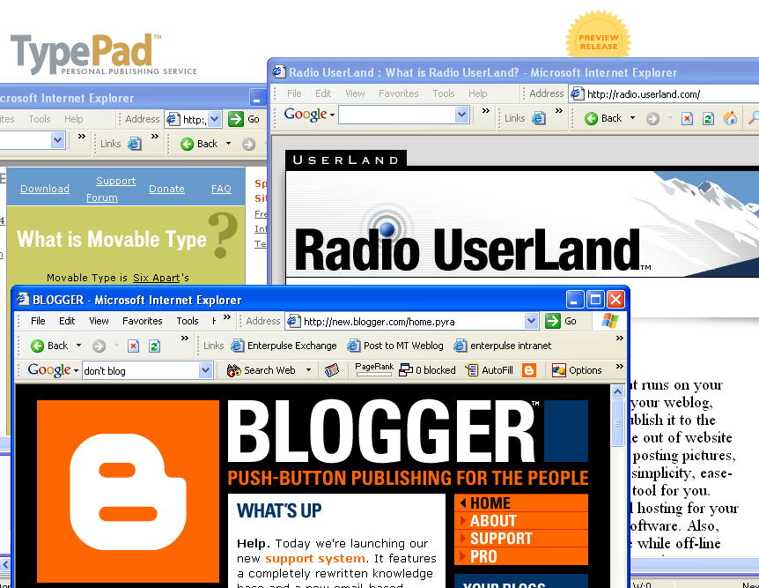
Choosing and Setting Up a Blog Tool
How to decide…

Slide 29
Best known blog solutions
Blogger and Blogger Pro (Google)
Radio (UserLand)
Movable Type and TypePad (Six Apart)
Not discussed today:
pMachine (pMachine)
Blosxom (Rael Dornfest)
Many others

Slide 30
Blogger and Blogger Pro
http://blogger.com/
Blogger has grown up alongside the blogging phenomenon and a number of people credit the ease of creating and updating a blog with Blogger for a huge part of the initial growth of the trend.
Blogger is an application that runs on the remote hosted servers of Google, which bought Pyra Labs, the company that introduced the software.
You access your blog’s content-admin interface directly through your web browser.
You can update your blog from anywhere that’s connected to the Internet.
Blogger stores your data remotely, generating the pages (the front page and the archive page) of your blog from a database and then placing the files on the web server. (The raw database contents should not be confused with the content of the actual rendered pages.)

Slide 31
Hosting (Blog*spot)
With Blogger, you have the option of hosting your site on a server provided by Google at a site called blog*spot (http://blogspot.com/) or you can host the site on your own server (or on a server provided by your ISP or by any other third party).
Blog*spot is a free ad-supported service, but there is also a fee-based option that removes the ads and offers some additional features (such as statistical tracking of your traffic).
You can start a blog with Blogger at one location and then later move it to a new address very easily.
The "cost" to doing so is in link breakage—all the people who have linked to you in the past will need to update their links to avoid this.

Slide 32
More about Blogger/Pro
Blogger’s user interface is fairly easy to understand and use. It’s an elegant implementation given the limitations of browser windows. Most people find it a snap.
Blogger makes it very easy to add team members to a blog, to enable multiple people to contribute to the same blog.
Blogger has online documentation and an interactive support feature.
Blogger posts do not include title fields for the entries, but if you upgrade to Blogger Pro (for $35 currently, with plans to go to $50 eventually), you gain that feature along with a few others:
The ability to post to your blog via e-mail
Automated image posting
A feature for posting drafts (without publishing them)
The ability to generate an RSS feed to syndicate your blog or its headlines
BlogSend, an e-mail broadcasting feature
The ability to change the time stamp on a post
Spell-checking

Slide 33
Radio UserLand
http://radio.userland.com/
UserLand founder Dave Winer publishes a tremendously popular weblog with UserLand software.
Radio is the entry-level product in a line of products that includes a web content management system called Manila and a scripting language called Frontier that underlies all the other products.
Unlike Blogger, Radio is the kind of software application you download onto your computer (or purchase shrink wrapped if you must have a trip to the mall) and install.It’s absurdly easy and fast to do so.
The way Radio works is that it sets up a new web server on your own computer (even if you already have one running there - they won’t conflict).
A live copy of the site running locally.
Radio then puts any new files on the Internet automatically, using a process they call upstreaming.

Slide 34
Desktop Blogging
Because Radio lives on your computer, if you want to be able to update your blog from anywhere, you have to leave your main computer turned on and connected to the ’Net (and not protected by a firewall), and then you’ll be able to log into it remotely from anywhere to work with your blog.
Radio stores your content in a database, of course, but this database is stored on your computer, not at some remote site on the Internet. This means you always have access to your data and you are free to back it up any way that’s convenient enough so that you’ll really do it regularly.

Slide 35
Radio Hosting
UserLand offers hosting as part of the basic Radio package, for $39.95 a year (for 40 megabytes of storage).
You can also upstream your Radio blog to any other ordinary FTP-style host (such as might be provided by your ISP), although the price is the same whether or not you take advantage of the hosting service.
There are currently at least three domains that run Radio community servers (Userland.com, Weblogs.com, and Salon.com) and there are some third-party community-server hosting sites running clones of RCS, UserLand’s Radio Community Server software (such as PyCS, written in Python).
Upon installing Radio, you have one free month to use the software on a trial basis (posting live on the Internet as much as you want during that period), so while it is not free like the basic Blogger service using the ad-supported blog*spot, it does enable you to experiment with it for a month before deciding whether you want to make a one-year commitment.

Slide 36
More About Radio
Unlike Blogger, Radio is designed to run only one blog, although it’s possible to use its categories feature to simulate separate blogs with their own identities and addresses..
There’s no specific team functionality in Radio.
Radio comes with a news aggregator also based on RSS, that enables you to subscribe to other blogs, websites, and news sources and regularly check headlines and even full-text articles. A built-in post button enables you to instantly grab an article from your aggregator and post about it to your blog.
Radio is more than a blog tool, as it offers an easy way to build an entire static site by dropping text files into a directory hierarchy and allowing the application to stream the new content, merge it with your templates, and build your site.
Radio has a MyPictures feature for easily upstreaming images to your blog (always helpful in softening text-heavy sites) and a built-in post-by-mail feature.
For blog editing, Radio includes a WYSIWIG editor for users of Internet Explorer on Windows (it doesn’t work with the Mac, so you need to know some HTML to get the most out of it).

Slide 37
Movable Type & TypePad
http://movabletype.org/ & http://typepad.com/
Movable Type has an image as a power-users solution, because its installation can sometimes be complicated and because it requires access to a remote host and a remote web server.
Six Apart, the company that introduced Movable Type, now offers a full-featured hosted service called TypePad that matches Blogger’s features, improves on the MT interface, and introduces new photo album, link list, and other auxiliary features.
Movable Type (often referred to as MT) runs off the web server hosting your site. (It consists mainly of Perl scripts that connect to a database.)
You access it through your browser and in fact can reach it from any browser on the Web.
The MT database resides on your host server, so you may want to download it and back it up from time to time.
You are not dependent on the software company’s servers (as with Blogger) to get access to your data.

Slide 38
Movable Type Hosting
As with Radio, if your site is ever damaged or deleted, you can rebuild it easily by republishing the rendered pages from the database.
Movable Type does not provide any hosting space (but TypePad does), and the assumption is that you are publishing directly to the same server (remote host) where you have installed the software.
For anyone not familiar with Apache, Perl, or even FTP, installing MT is probably the greatest barrier to adoption, especially if one is relying on a paid remote host with restrictions on things like what sorts of CGI scripts can be run.
Six Apart offers a fairly cheap paid service to help you get going (the software itself is free), the documentation is good, there are troubleshooting tips throughout, and there is a well-attended support forum hosted at movabletype.org.

Slide 39
Other MT and TP Features
MT and TP offer multiple category assignments for entries, a comment features (Blogger does not offer a comments feature), and some beautifully designed templates (TP has an interface for modifying its CSS-based templates without touching the markup).
Trackback enables you to see and publish links to other blogs discussing your entry or a common theme
You can create an unlimited number of blogs from a single installation of MT.
TP has various pricing options, some of which permit multiple blogs.
For many people, one blog is probably more than enough, but if you are involved in the maintenance of more than one website, then you may find that you’d like to generate one or more unique blogs for each site.

Slide 40
More About MT
Like Blogger, Movable Type has a built-in Team function that enables multiple authors to contribute to a single blog.
To some, the use of Movable Type identifies you as an experienced or advanced blogger.
MT’s interface offers the ability to write short and long versions of the entry as well as an excerpt, so the RSS feed can be set to just send out the short version—a neat trick.
With MT (as with Blogger), if you have multiple blogs, you only need one bookmarklet (a bookmark that grabs the current page for posting to your blog) and you can choose which blog to publish to on the fly.
Movable Type is free for noncommercial use, but paying $20 gets you technical support and a listing on the MT home page when you update your blog. Paying $45 (these are one-time payments) gets you instant-messaging (IM) tech support from Movable Type’s principals.
A Pro version of MT is in the works, and it’s expected to incorporate some of the new features debuting in TypePad. Anyone who has contributed and decides to pay for the "pro" version will be credited for their payment so far.

Slide 41
So, How to Choose?
If you know you need the software to be free, that rules out Radio and TypePad.
If you want the data to be in your direct control, that rules out Blogger.
If you don’t have access to a web server, and don’t anticipate getting any, that rules out Movable Type.
It’s easy to experiment with Blogger, since it’s free.

Slide 42
Where the Client Software Lives
If you want the client (the software) to run on your own computer, then rule out Blogger, Blogger Pro, and TypePad, as well as Movable Type unless you have a web server on your local computer and can install MT there.
If you want the client to run on a remote server (accessible), then rule out Radio, unless you can make your computer available all the time on the Internet from anywhere.

Slide 43
Where Your Data Lives
If you want to keep the data stored on your own computer, rule out Blogger, Blogger Pro, TypePad, and Movable Type (unless you can install MT on your home computer).
If you don’t want to be responsible for the data, use Blogger or Blogger Pro.

Slide 44
Where Your Site Is Hosted
Blogger (and Pro), Radio, and Movable Type all enable you to host your own site on your own server (or on server space provided for you, such as by your ISP), if this is what you wish to.
Blogger (and Pro), Radio, and TypePad all offer hosting solutions.
If you want the hosting to be taken care of by the blog software provider, rule out Movable Type.

Slide 45
Ease of Installation / Getting Started
If you want to guarantee the easiest possible "ramp up" to starting your blog, rule out Movable Type (unless you’re a power web user already or can pay them to install it for you).
Blogger is a matter of signing up and filling out a form, and UserLand boasts that you can set up a blog and start blogging in under five minutes.

Slide 46
Design Templates
The design templates are not really a differentiator among the blog tools, since each tool offers a range of choices and certain similar options are available for all of them (with minor differences, such as the lack of a calendar view in Blogger but the availability of such as view in Radio and Movable Type).
Furthermore, all the blog templates are fully customizable the same way you edit HTML (and XHTML and CSS) files. You’re fine if you use them as is and you’re fine if you want to adapt them or develop your own templates.
TypePad offers the greatest flexibility for those who are not web-design experts.

Slide 47
User Interface and Ease of Use
User experience can be subjective, but you can get a sense of the design values of each of the three companies by visiting their web sites and looking at screen shots of the software.
Personally, I rank TypePad’s interface first aesthetically, then Blogger’s, then Movable Type’s, and then Radio’s, but I think they are all of very high quality and this is subjective.

Slide 48
Multiple Authors
Blogger (and Pro), Movable Type, and TypePad make it very easy to set up team blogs with multiple contributors. If this is your main purpose, I’d use one of them.
Radio can be set up to do something similar, although it does depend on all of the contributors being able to generate RSS feeds from their own blog software.

Slide 49
“Blog This!”-style Bookmarklets
Blogger/Pro, MT and TP provide bookmarklets for snagging web pages and posting links to, and excerpts from, them.
There is a plug-in for Radio called Radio Express! that has a similar effect, although it is not designed quite as effectively (mainly, it doesn’t pop up in a new window, which makes it a little more difficult to go back and copy text after the fact).
Radio also has its aggregator with its built-in post function that provides a similar functionality (it quotes the entry you are blogging about and captures its URL for the link), but only for sites you’ve already subscribed to (bookmarklets can be used on any page showing the web browsers).
The bookmarklets are all "installed" the same way. You drag a JavaScript link onto your browser’s custom toolbar to give yourself a doo-dad that enables you to grab the link to any site you happen to have browsed to, write up some description, quote part of the page (it will capture whatever you’ve got selected automatically), and instantly publish the new entry to your blog.

Slide 50
Comparing Price
Blogger and Movable Type can both be used for free, if you provide your own hosting (or use the ad-supported blog*spot hosting with Blogger).
Radio costs $39.95 a year for the software with the hosting thrown into the deal.
Movable Type is free for noncommercial use, but paying $20 gets you technical support and a listing on the MT home page when you update your blog.
For commercial users, MT is $150.
Blogger Pro currently costs $35 but is going up to $50.
While not free, Radio does give you a one-month trial period so that you can at least sample the wares (and perhaps get hooked on them) before you pony up the dough.
Princing for Movable Type Pro and TypePad were not available at the time of this writing.

Slide 51
Setting Up Blog Software
You don’t "download" and "install" Blogger. You just sign up at the website to get started.
With Radio, you download the software and install it on your own computer. Radio assigns you a usernumber and sets up hosting for you automatically.
With Movable Type, you fill out a form at the MT website, download the installation files, customize them for your server, upload them to your host, and run an installation script.
With TypePad, you sign up at the website (just as with Blogger).

Slide 52
Starting a Blog
Name and describe the blog
Tell the software where the blog is hosted
Choose a basic layout template
Depending on the software you’re using, the steps can occur in any order, although the naming should generally be the first step.

Slide 53
Naming Your Blog
“Traditionally,” every blog gets a name and a description, although the name is much more important.The description is also sometimes referred to as a tagline and it might be a slogan or motto rather than a dry descriptive phrase.
Technically, you can always change your blog’s name and description later but you might as well try to pick something good now so you can start "building your brand" right away. (Actually, changing the description is not such a big deal, but changing the name can confuse people if you’ve been at it for a while.)
The name and description should reflect the nature of your blog (professional, personal, topical), such as: "Joe’s Notebook: The Life and Times of Joe" or "Stars in My Pocket: Samuel R. Delany Fanclub Blog" or "Fight the Man: mom don’t read this" or "K-Flow in the e-Sphere: a blog of incomprehensible business jargon.”

Slide 54
More on the Name and Description
Naming your blog is important. Some people will follow links to your blog just based on the name if it’s intriguing enough. This can be very helpful in getting a blog launched and in making it stick in people’s minds.
Change your tagline as much or as little as you like. Some people pop up a different motto each time you visit their blogs, dynamically.
Most blog tools will capture one default description or tagline for your blog. One thing a description does is help people who want to link to your blog but do not want to write their own blurb describing it.

Slide 56
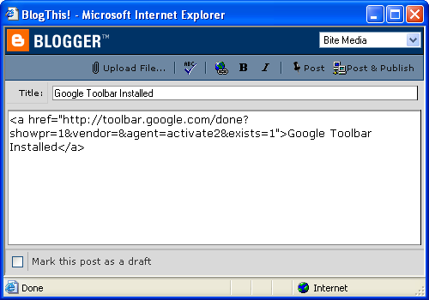
Push-Button Publishing
The nuts-and-bolts of posting

Slide 57
Posting Entries to a Blog
Using the blog tool’s web interface
Posting a new entry from scratch
Using a bookmarklet
Using a client-side application
Using a stand-alone weblog posting tool
Using a news aggregator with posting features

Slide 58
Posting a New Entry
Go to the Web-based interface:
Blogger http://blogger.com/
Radio http://127.0.0.1:5335/
Movable Type http://path/to/mt/mt.cgi
TypePad http://typepad.com/t/app/
Start a new entry
Type a title (optional)
Give the post a main link (optional)
Write your entry
Format with web-based (DHTML) or wyziwyg interface if provided
Type a longer/continued entry (optional)
Type a summary (optional)
Add key words (optional)
If ready (date/draft status), click Post/Save/Publish.

Slide 59
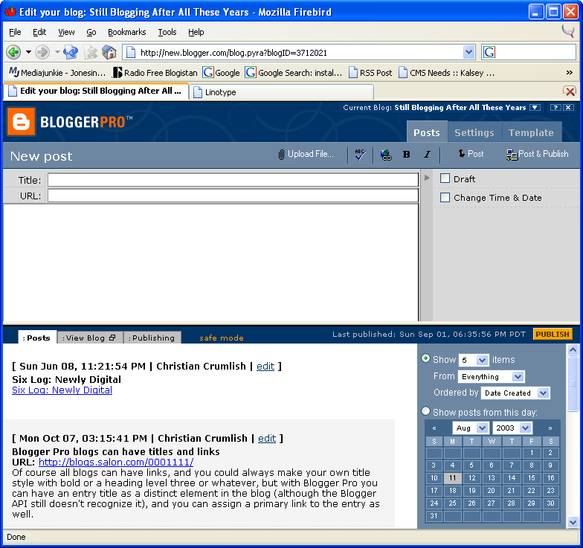

Slide 60
Posting with a Bookmarklet
Make the bookmarklet first (drag link to Links bar)
Blogger has one-size-fits-all (BlogThis!)
Movable Type and TypePad have customizable bookmarklets (Post to MT Weblog and QuickPost)
With Radio you can add a third-party bookmarklet called RadioExpress!
When browsing a page you want to blog, select any text you’d like to quote.
Click the bookmarklet
The page title, link text, and quotation are automatically added to the entry box in the pop-up window that appears
Add a post title (optional) and write an entry around the resource to which you are linking.
Click Post/Save/Publish.

Slide 61
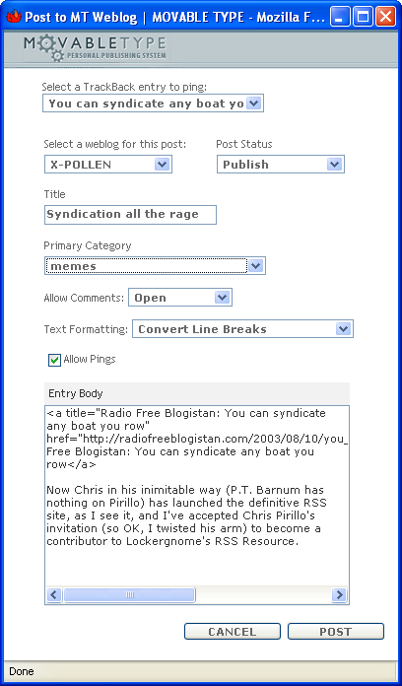

Slide 62
Posting from an Application
There are many (mostly third-party) stand-alone tools for posting to weblogs (at this time they either use the Blogger API or the MetaWeblog API developed by UserLand mostly as an extensio to the Blogger API – it includes titles, categories, and other things like that not offered with the original blogger interface).
Some use RSD (“Really Simple Discovery”) to figure out the URL of the blog’s posting interface from its own URL (this requires a LINK REL= tag in the head of the index document.
Windows:
w.bloggar (Blogger)
Zempt (Movable Type / TypePad)
Mac
Frequency (Blogger)
Kung-log (Movable Type, but any MetaWeblog-aware blog tool)

Slide 63
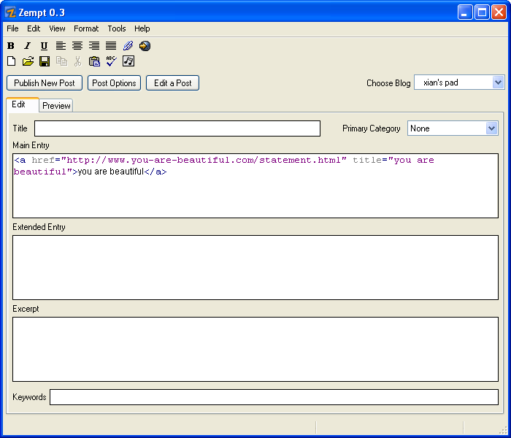

Slide 64
Posting from an Aggregator
Aggregators are applications designed for reading syndicated (RSS) feeds. Some of them include the ability to grab an entry and post about it to your own blog, which tightens the blogging loop considerably
There are many, many aggregrators, most of which standalone but some are web based, and others plug into existing applications (such as NewsMonster, which plugs into Mozilla, and NewsGator, which plugs into Outlook)
Aggregators you can post from include NetNewsWire (the Pro version) for OS X, and NewzCrawler, FeedReader, FeedDemon, NewsGator, SharpReader, RSS ndit, and others for Windows.
There’s a fairly complete list of aggregators maintained at Lockergnome’s RSS Resource (http://rss.lockergnome.com/), a news site to which I am a contributor

Slide 65
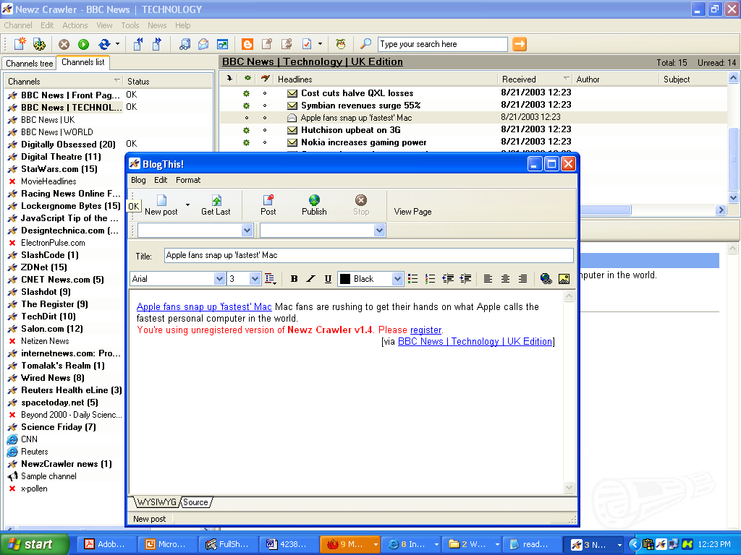

Slide 66
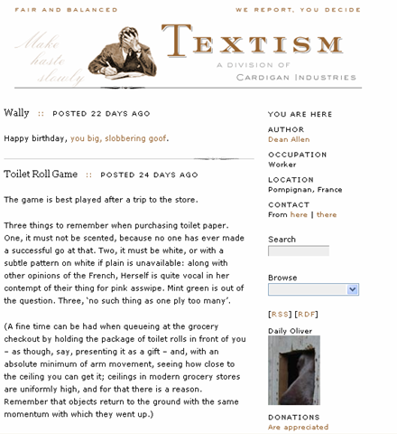
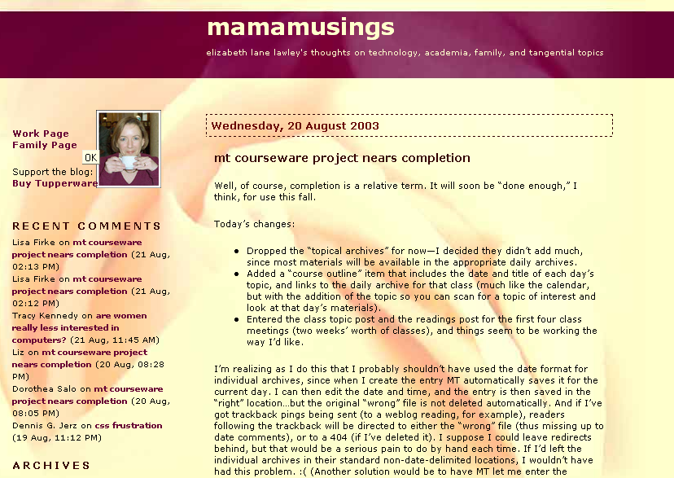
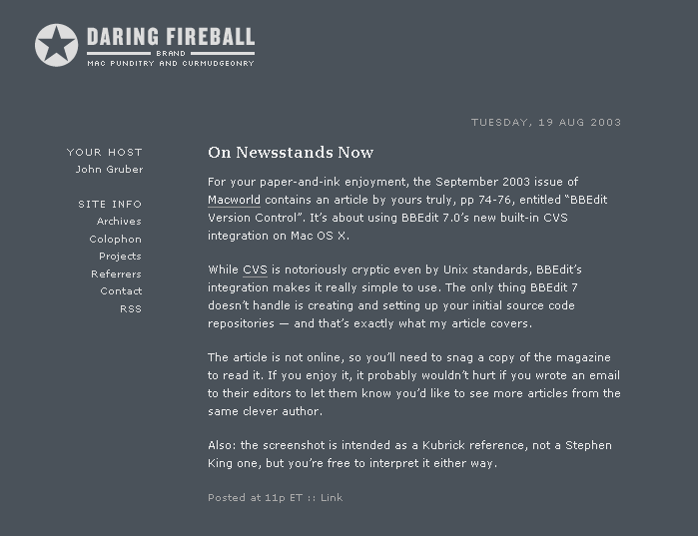
Designing a Weblog
Standing out while fitting in

Slide 67
What’s Required?
Are you merely looking to distinguish your blog from the rest of the pack without fundamentally changing the underlying design or organization? In that case, you can probably get away with a little tweakage.
If your goal is to add a blog to an existing site (say, to solve an ongoing content-management problem) then you’ve got an integration project on your hands.
If your goal is to create a unique design from scratch or to develop a multipurpose page design that includes other major elements besides the blog portion of the page then you’ll need to do some good ol’ web design, which involves not just laying out an interesting page but also thinking about navigation (and backend organization for the nonblog elements).

Slide 68
Weblogs are Web Pages
Fundamentally, weblog design is web design. Typically page elements include:
Banner
Main content column
One or two smaller side columns
Rarely, a footer
Weblog IA depends on categories and archive styles, but generally:
Home page
Archive pages

Slide 69
Designing with Templates
Weblog tools use templates to render pages from content stored in a database (and custom tags to indicate where to flow)
Generic weblogs have generic templates
Establishing your personal brand or matching your weblog to an existing site require updating or replacing the templates with your own
When CSS-based (as with MT and TP templates), it’s easy to play with the CSS file to try out design changes, but structural changes require both adding new style definitions and applying them to the page templates.

Slide 70
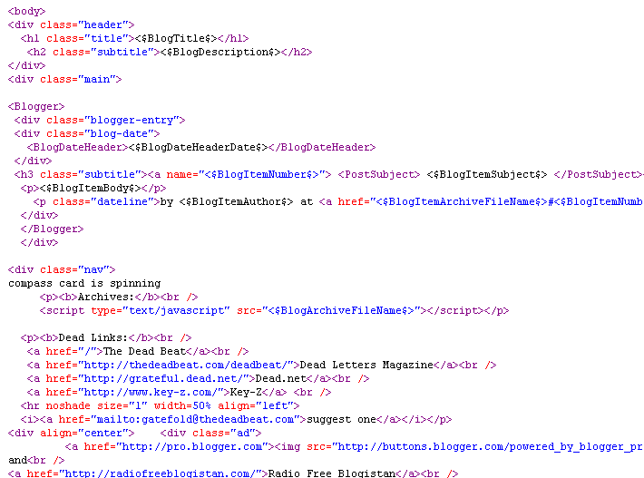
Templates are Mostly HTML

Slide 71
Edit Templates in Your Favorite HTML/Web Development Program

Slide 72
Integrating a Blog
To add a blog to an existing site requires merging weblog templates with existing static pages or existing CMS templates
Archive pages need a compatible look-and-feel but don’t have to be integrated
To have a blog show up on your site’s home page, you can use includes (if there are other dynamic elements on the page) or just allow the blog tool to redraw your home page each time you publish new content

Slide 73
Principles of Blog Design
Blogging is a content (=text =writing)-centric medium. The design should support legibility and clarity.
Alongside the main content area, the sidebar(s) generally consist of a sequence of content blocks and/or lists that can complement the stream of fresh content.
A mix of standard elements to orient people familiar with the weblog form with innovations that demonstrate mastery of the form of fresh thinking is always welcome.

Slide 74
Doing a Custom Design
For the most adventurous web designers, the ultimate blog design challenge is to create your own page design not by tweaking sample designs or by making the page fit in with your brand guidelines but entirely from scratch. If you know how to design web pages, then this is not so hard. It’s basically a two step process:
1. Design the page.
2. Add the custom tags.
That’s it. Coming up with a fresh new design that works for a blog but doesn’t look like everybody else? That’s the hard part.

Slide 75
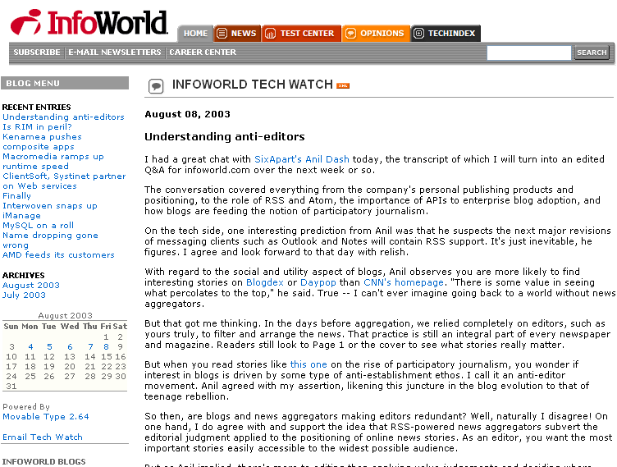
Some Design Examples
Kottke.org
InfoWorld Tech Watch

Slide 76
Launching a Blog
Announcing…

Slide 77
When to Go Public
Timing the public launch of your blog
Get a running start, some momentum
Make sure the blog is going to last
Blogging in private
Do not set up your blog to notify the list of recently updated blogs maintained by your blog software provider.
Do not set up your blog to ping Weblogs.com, blo.gs, or any of the other sites that track updated blogs.
Do not link to your blog from any other site you manage, and make sure that no one who knows about the new blog links to it either, until you are ready. Speaking of robots, to be doubly safe from discovery from search engine, you can add a robots.txt file to your site’s root to warn any visiting robots not to index the site if they do happen to stumble across it somehow.
Password-protect your site (.htaccess), because if you link out, your URL will appear in the referrer logs of the sites you link to.

Slide 78
Promoting a Blog
Basic/easy/automatic things
Ping weblogs.com and blo.gs
Add blog URL to your Email signature
Send announcements to key influencers
Interacting with readers and other webloggers
Comments (respond to other blogs)
Trackback (notify blogs when you link to them)
Blogrolls (list of favorite links)
Email “A-List” or “Node” bloggers when you have posted something you think they might be interested in linking to

Slide 79
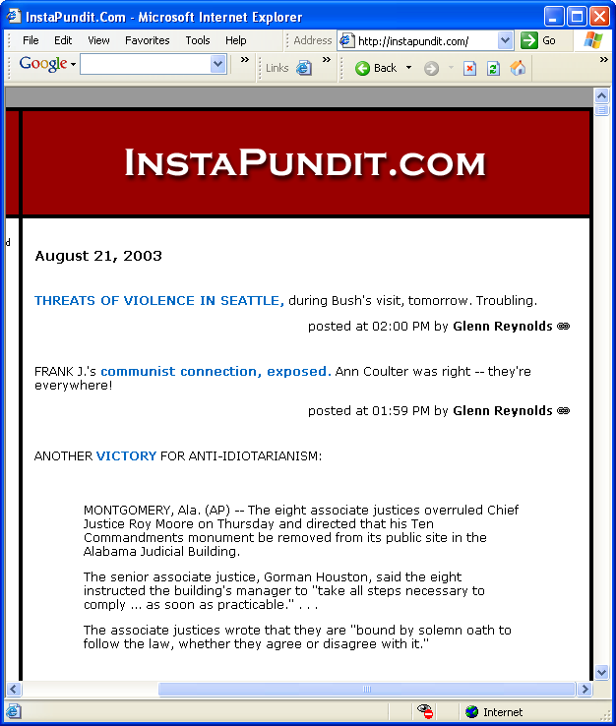
Blogging Effectively
Maximizing the impact of your weblog

Slide 80
Respect Your Readers
Write for yourself, yes, but…
To get people to show up and then come back, you must reward your readers with useful, well written content that’s well organized and easy to read. In the long run, it’s the quality of your readership that will matter, not the raw quantity. High traffic numbers are exciting, and it’s tempting to do whatever might be necessary to constantly drive up your readership, but unless you’re willing to pander to people’s basest interests or chase the latest news item or ascendant meme, your better off building up your readership by word of mouth and by providing consistently high-quality content focused on the subject matter you have decided to cover.

Slide 81
Stay Focused
Visualize your audience: Is it people like yourself, who work in the same field you work in and know all the same jargon? Is it a wider audience than that? Is your audience composed of people who are trying to learn about your field but may not yet know all the lingo?
Stay on Topic: If you want readers to come back as often as daily to read your latest entries, then you need to make sure they can reasonably predict what you’ll be writing about. Staying focused on a topic enables you to build a dedicated readership. (For multiple topics, use categories).

Slide 82
Encourage Feedback
Write entries that invite feedback. Leave openings in your ideas for other to contribute.
Most readers have learned to be passive and will be perfectly happy just reading your blog and never responding.
A small minority might become very vocal and start responding to every entry you post. A
smaller group will respond very occasionally, when the spirit moves them.

Slide 83
Consider Comments
Enabling Comments:
Blogger has no built-in comment feature (although there are third-party services that can be plugged in).
Radio has comments but you have to turn them on.
Movable Type has comments that can be turned on or off on a per-entry basis, and which can be closed to further discussion at any point. (MT also has IP banning in case you get comment spammers.) MT comments have other configuration choices as well (allow HTML in comments? Etc.)
TypePad is similar to MT except that at some payment levels you don’t get per-entry control over comment settings.
Moderate your commenters: That is, establish and maintain standard of discourse.

Slide 84
Knowledge Capture and Retrieval
Making sure your blog is searchable

Slide 85
Data Mining a Blog
The power of blogging comes from the ease of posting, the ease of data entry, the ease of contribution to a knowledge store.
New entries are time stamped, may get a category assignment and often have a title.
Blogs are not good at automatically building a directory of content, however.
The repository builds up nicely but getting at the information isn’t straightforward, since the main organizational scheme is chronology, which is content-neutral.
The workaround: Search-enabling your blog.

Slide 86
Making a Blog Searchable
Movable Type and TypePad have search built in.
Blogger and Radio require third-party search solutions.
It’s easy to provide a custom Google search for your site.
It requires signing up for an account.
By default it searches the entire domain name
You can use custom hidden queries to specify just one subdirectory at a root domain: http://radiofreeblogistan.com/stories/2002/09/30/finetuningCustomGoogleSear.html

Slide 87
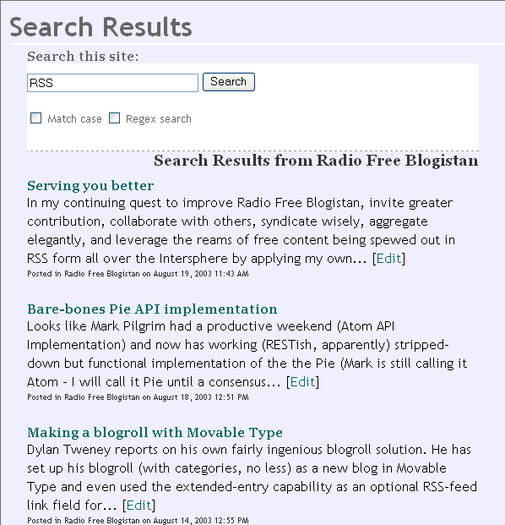

Slide 88
Preserving Links
Ways to save links
Blogrolls
Link lists in generals
Directories
Managing Links
Blogrolling.com
Blo.gs
Making a links sideblog (more on that later)
Making a TypeList (TypePad only)
Publishing an OPML (outline) file

Slide 89
Blogging Just Links
Like the earliest, “filter”-type weblogs, one current trend is to have link blog on the side of an essay-type blog.
Not a blogroll (“blogs/sites I read”) so much as a “recently browsed” or “interesting links” also called “low-threshold” links that don’t call for an extended entry.
A collection of links, if categorized, becomes directory. (You can create outlines and directories with OPML in Radio.)
Dylan Tweney explains how to make a link blogroll/directory with categories (http://dylan.tweney.com/weblog/000611.html)
Link logs often use the title attribute of an anchor tag to produce a floating tool-tip description.
Blogger and Radio, which call for title/link/description best suited to this format. Movable Type users have to “reinterpret” existing fields (such as description and extended entry) to make room for the link, since there is no native link field.
TypePad features link lists (TypeLists).

Slide 90
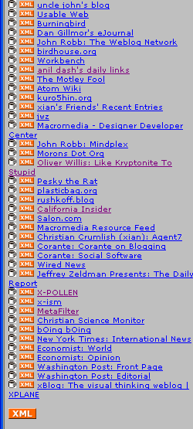
The Power of Syndication
Are you producing an RSS feed yet?

Slide 91
What is Syndication?
An update-notification method.
A way to distribute content (opt-in/push).
A de facto standard format for agile web content (usually one of the flavors of RSS, possibly in the future “Pie” as well).
An enabler for the tightly knit feedback loop among news outlets, webloggers, search engines, and other readers of the Web.
Originally headlines/titles only (with links to the full content).
Now syndicated feeds usually contain an excerpt or even the full text of entries.

Slide 92
Producing a Syndicated Feed
Blogger now offers optional RSS 1.0 feeds (and plans to support “Pie”).
Radio creates RSS 2.0 feeds of your blog and each category automatically – it’s actually tricky to turn this off - (and may support “Pie” as well).
Movable Type by default produces an RSS 1.0 and and RSS 2.0 feed (and will support “Pie” as well).
Other CMSes can produce RSS easily with the addition of a relatively simple template.

Slide 93
What is the Syndicated Feed?
An XML (usually) representation of your content
A fixed number of most-recent (usually) entries, often 15.
No HTML/presentation information
There is a channel element at the top level of the feed
Each entry is an item in the feed
Each item has a title, link, and description
RSS 1.0 (RDF) and RSS 2.0 syntax are very different but the fundamental purpose is the same.

Slide 94
Syndication Decisions
Syndicate your blog, yes or no? If not, you may be dropped by people too busy to visit.
Include full-text feed or just excerpts?
If excerpts, do you write summaries or use auto-excerpts
If auto-excerpts, how many words/characters?
RSS and/or “Pie”?
If RSS, which version (1.0 or 2.0)?
All of the above? (Safest, but redundant)
Make custom feeds (comments, categories, queries)?

Slide 95
More on RSS and Syndication
See Lockergnome’s RSS Resource (http://rss.lockergnome.com/)
Feedster - RSS feed search (http://feedster.com/)
RSS 2.0 Spec (http://blogs.law.harvard.edu/tech/rss)
RSS 1.0 Spec (http://web.resource.org/rss/1.0/spec)
The “Pie” Wiki (http://intertwingly.net/wiki/pie/FrontPage)

Slide 96
Tracking the Blogosphere
Spotting Trends and Virtuous Cycles

Slide 97
Blogosphere Trends
There seem to be more of these everyday.
Daypop (http://daypop.com/)
Blogdex (http://blogdex.net/)
Blogpop (http://blogpop.com/)
Technorati (http://technorati.com/)
Blogosphere.us (http://blogosphere.us/)
Lafayette (coming soon)
And so on…

Slide 98
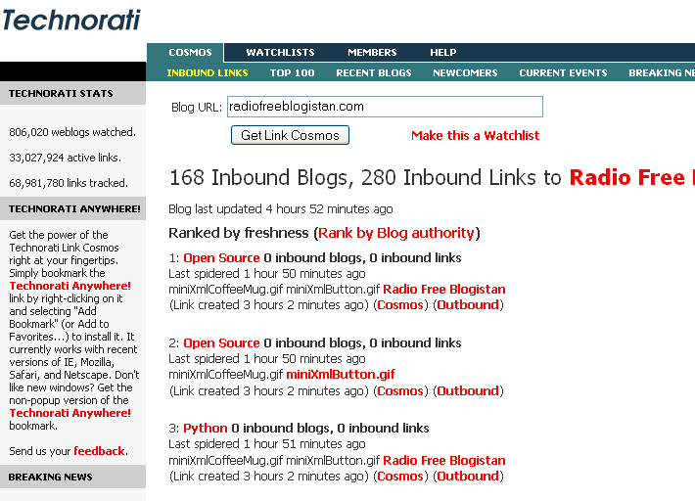
Technorati

Slide 99
Tracking Your Own Cosmos
Who is linking to me?
Referrer logs
Trackback pings
Related websites
Ecosystem, recommendation sites
Surfing upstream
Follow incoming links back to their source
Discover likeminded or otherwise interesting bloggers
Follow some of their outgoing links
Blog about new items that catch your fancy (and credit the blogger whose “Memex” trail you followed)

Slide 100
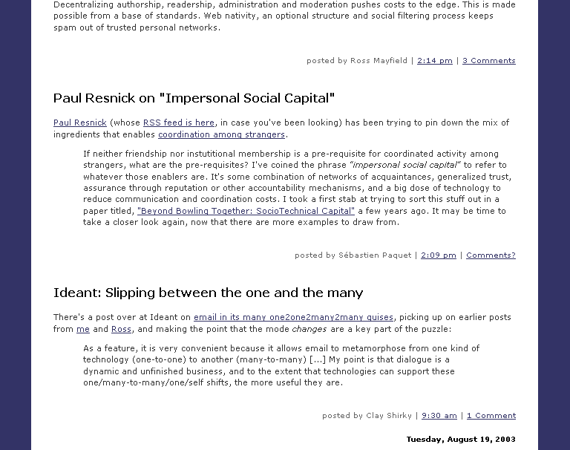
Creating a Multiauthor blog
Many-to-many

Slide 101
How to Do a Multiauthor Blog
A multiauthor blog can have a more traditional editorial workflow (some can edit or approve other’s posts)
Blogger has a “team” function for inviting contributors
Movable Type has something similar. Contributors can be given a limited set of privileges (can post but not delete, can rebuild pages but not create new blog, etc.)
Typepad Pro has ability to create three levels of author types (junior authors)
Radio has no multiauthor capability except for an RSS feed aggregator autoposting tool you can install (used, for example, to create Mediajunkie feeds page)

Slide 102
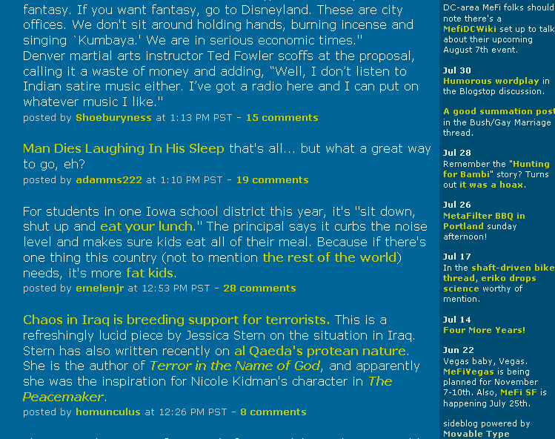
Blogs within Blogs
Sideblogs, Ping metablogs, and other tricks

Slide 103
Multiple Blog Pages
Today many blogs include a sidebar with “quick links” not unlike the earliest filter style blogs. This is a blog-within-a-blog.
Metafilter has a sideblog driven by Movable Type (although the primary content at MeFi runs on ColdFusion custom coded by the site’s founder).
A sideblog is another blog that is included in the main page using a server-side include or – as with MT – a custom code.
A ping metablog is a category at a blog that aggregates incoming Trackback pings all on the same topic or subject matter.

Slide 104
Syndicated Glue
If adding multiple feeds or content-streams to one page, they might all be coming from within one blog (Radio, TypePad + TypeLists), all from the same installation (Movable Type + MTotherblog plug-in, pMachine Pro), all on the same server (any blog tool w/ includes), or …
If you can parse RSS (or any syndicated feed) files, you can display headlines, links, and even excerpts or full text anywhere on your blog pages.
Radio RSSbox, multiauthor weblog tool
MT with MTrssfeed (Tim Apnell) plug-in!
RSS Monkey (for single feeds)
Dynamic vs. static: date context, current vs. when published.

Slide 105
Category Tricks
Blogger doesn’t have categories
Radio and MT do, fairly similar
With MT, can exclude category from main content area and then include the category in its own context in a sidebar (or elsewhere).
With Radio, category content may be left off main page. Putting it elsewhere is easy. Getting it back on the main page requires a hack like an RSSbox macro.
Same issues with static vs. dynamic pages, when rendered.

Slide 106
Professional Blogging
Blogging for ‘the Man’

Slide 107
Blogging as a Professional
External blogging issues for professional
Public Relations
Marketing Messaging
Not getting fired
Paradox of authentic voice
Example of successful professional blogger: Robert Scoble. He’s become an evangelist for Microsoft and his Scobleizer Weblog was instrumental in his landing the job and in his execution of it.
Ownership of blog content, Robb’s Law (“Never post to a domain you don’t control”)
Internal blogging applications
K-logs
Project Management

Slide 108
Mastering Your Domain
Remember Robb’s Law

Slide 109
Controlling Your Own Content
Host your blog at your own domain
Can use domain redirection to store blog on a hosted site (such as TypePad, Plus or Pro users only)
Backup your data!
Use permalinks that are really permanent
Moving or migrating a blog involves republishing it to a new location, but also dealing with the links to the old location.

Slide 110
Further Weblog Reading
Good blogs on blogging and nanopublishing
Blogroots.com (http://blogroots.com/)
Corante on Blogging (http://corante.com/blogging/)
Weblogging for Poets (http://weblogging.forpoets.org/)
A Klog Apart (http://www.dijest.com/aka/)
How to Change the World (http://blogs.salon.com/0002007/)
Microdoc News (http://microdoc-news.info/)
Plasticbag.org - about a lot of other stuff too – (http://www.plasticbag.org/)
See Also
Learning from Weblogs (http://www.plasticbag.org/files/misc/v_comm.ppt)

Slide 111
Thank You for Your Time!
Christian Crumlish (xian)
http://radiofreeblogistan.com/

